Slide 1



Making better conservation decisions
Jeffrey Hanson
jeffrey.hanson@uqconnect.edu.au
jeffrey-hanson.com

Slide 2


Acknowledgements
Allison Binley
Amanda Martin
Angela Brennan
Brandon Edwards
Caitlyn Proctor
Dobrochna Delsen
Emma Hudgins
Martin Jung
Matthew Strimas-Mackey
Iadine Chadès
Hugh Possingham
Jaimie Vincent
Jenny McCune
Joseph Bennett
Josie Hughes
Lenore Fahrig
Melissa Chapman
Nina Morell
Peter Arcese
Piero Visconti
Richard Schuster
Richard Pither
Virgilio Hermoso

Slide 3
Now
Biodiversity
Status quo
2000
Future

Slide 4
Now
How do we
get here?
Biodiversity
Status quo
2000
Future

Slide 5
How can we get a better conservation decision?
(1) Better algorithms
(2) Better data
(3) Better surrogates

Slide 6



Ecological surveys
Distribution maps
Priority areas
Biodiversity
2000
Future
Data
Information
Plan
Outcome
Objectives
Constraints

Slide 7
Ecological surveys
Distribution maps
Priority areas
Biodiversity
2000
Future
Data
Information
Plan
Outcome
Better
algorithms
Better
outcome
Objectives
Constraints

Slide 8
Reserve selection
Features
Notes:
- not all remaining habitat can be preserved
- achieve conservation objectives for minimal cost
- modern systematic conservation planning primarily focusses on representing species
- however, this ignores intra-specific biodiversity
8

Slide 9
Reserve selection
Planning units

Slide 10
Reserve selection
?
?
?
?
?
?

Slide 11
Reserve selection

Slide 12





Heuristic
algorithm
Meta-heuristic
algorithms
Exact
algorithms
Estimate of best quality
Quality
Different
solutions
Different
solutions
Different
solutions

Slide 13

prioritizr: Systematic conservation prioritization in R
It’s an R package (yes, this is good)
First released on CRAN in 2016
Highly flexible interface
Supports tabular and GIS data formats
Supports multiple zones/actions
Powered by open source and commercial exact algorithm solvers
prioritizr.net

Slide 14
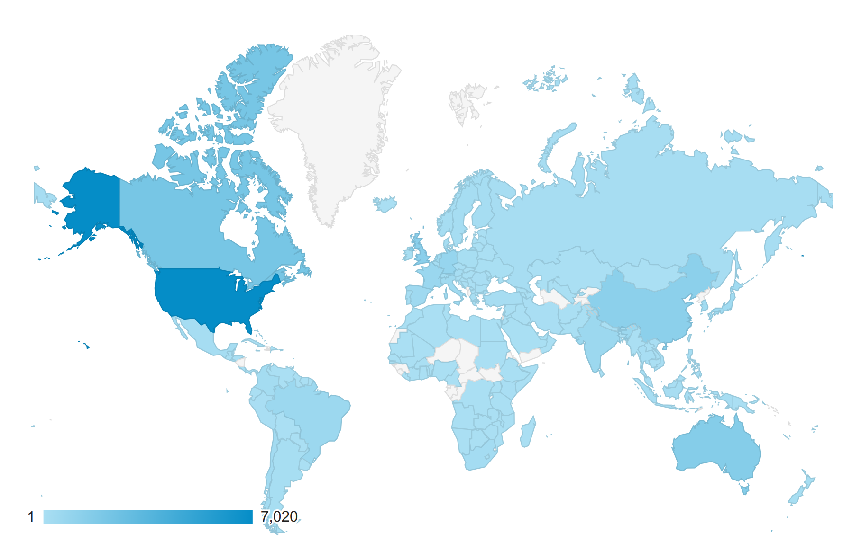
Who uses it?
Web site visitors
85 scientific publications used it for generating prioritizations
Conservation International, Nature conservancy Canada, UN Biodiversity Lab, Waitt Institute
Helped inform planning for Government of Monsterrat, Scottish Government, US Geological Survey, Governments of the Maldives and the Federated States of Micronesia

Slide 15
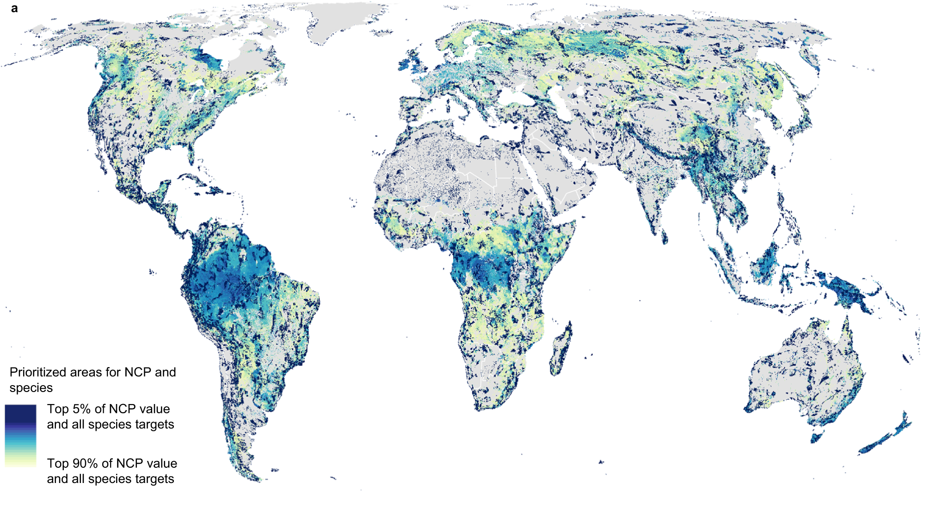
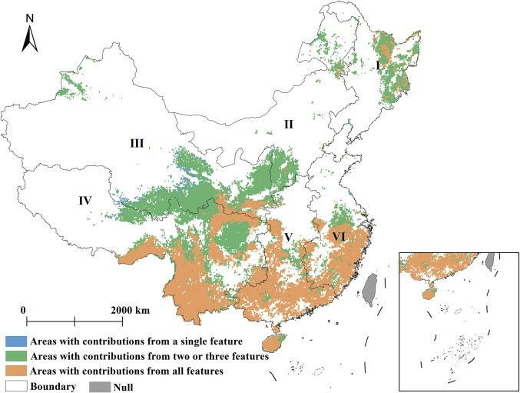
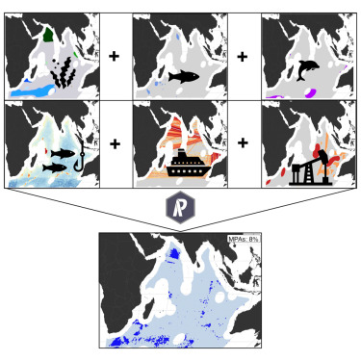
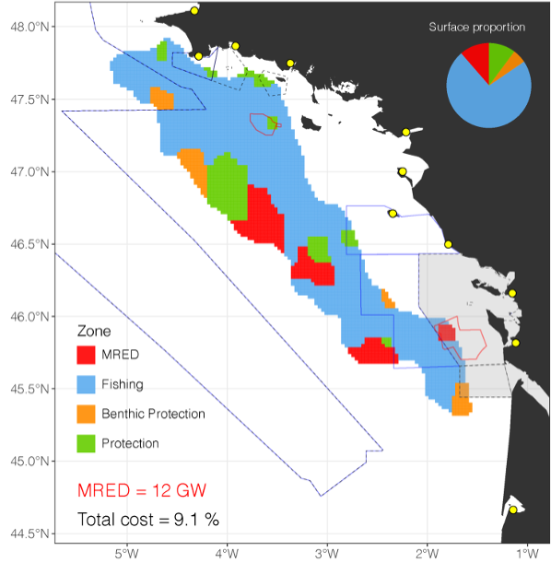
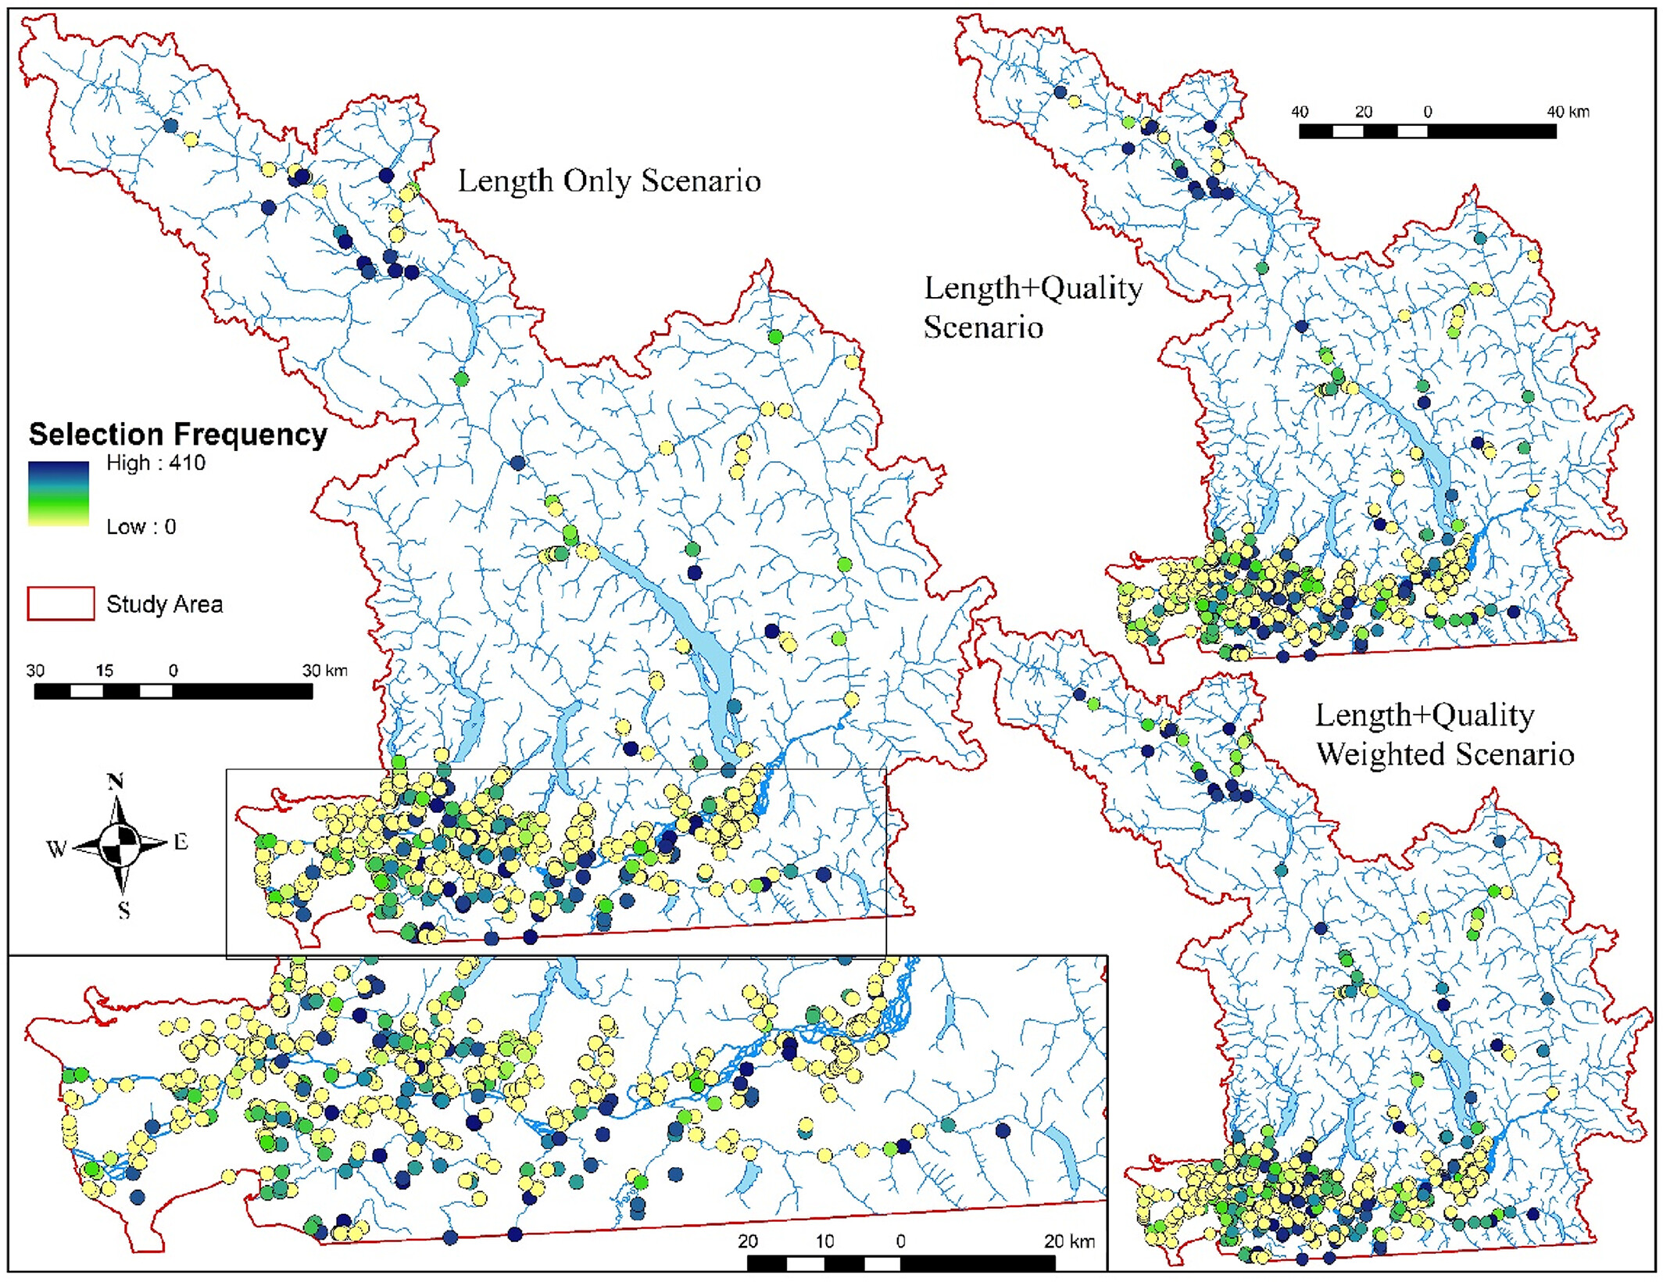
Recent applications
National-scale priority areas for protected areas
Priority areas for ecosystem services and biodiversity conservation
Cross-sectoral marine planning in the high seas
Neugarten et al. (2024) Nature Comms
Fourchalt et al. (2024) One Earth
Du et al. (2024) Ecol Indic
Priority areas to remove in-stream barriers for salmon connectivity
(e.g. dams, weirs, road culverts, pump stations
Priority areas for renewable energy areas and marine protected areas
Boussarie et al. (2023) J Env Managem
Finn et al. (2023) Cons Sci Prac

Slide 16
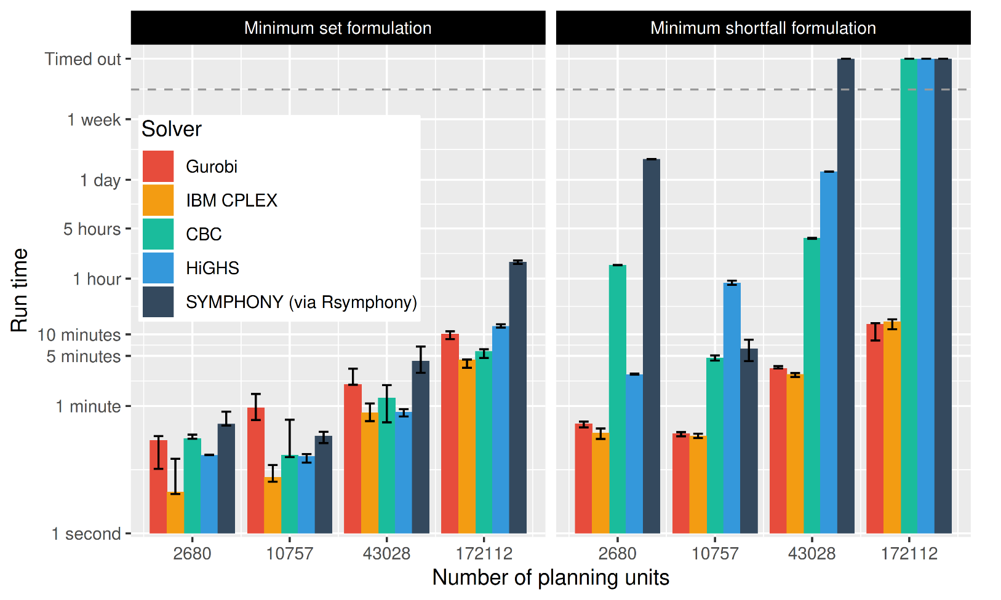
Solve problems pretty quickly!
Notes: 396 features, no planning units locked in or out, prioritizations ≤ 10% from optimality
Hanson et al. under review

Slide 17
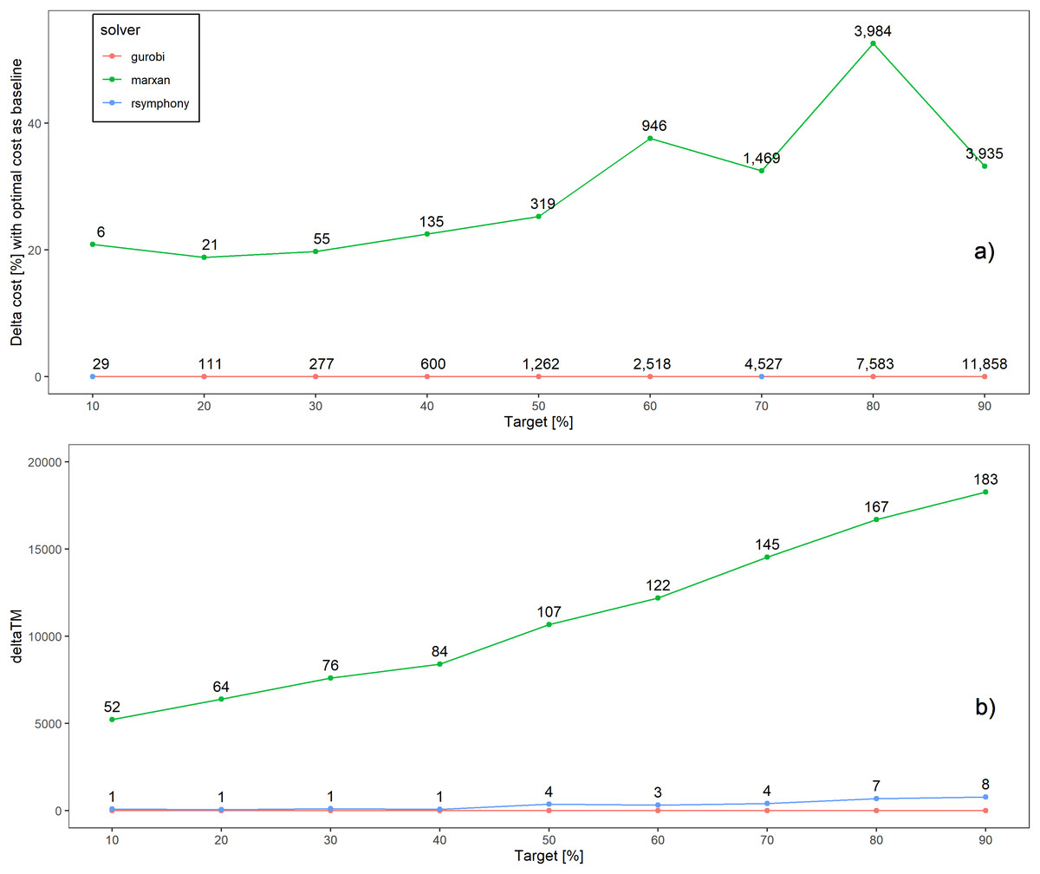
Better solutions
Schuster et al. 2020 PeerJ

Slide 18
Faster too
183x slower
52x slower
Time difference
Schuster et al. 2020 PeerJ

Slide 19
How can we get a better conservation decision?
(1) Better algorithms
(2) Better data
(3) Better surrogates

Slide 20
Ecological surveys
Distribution maps
Priority areas
Biodiversity
2000
Future
Data
Information
Plan
Outcome
Objectives
Constraints

Slide 21



Ecological surveys
Distribution maps
Priority areas
Biodiversity
2000
Future
Data
Information
Plan
Outcome
Data on
threats
Better understand
threat impacts
Better
management
Better
outcome
Objectives
Constraints

Slide 22
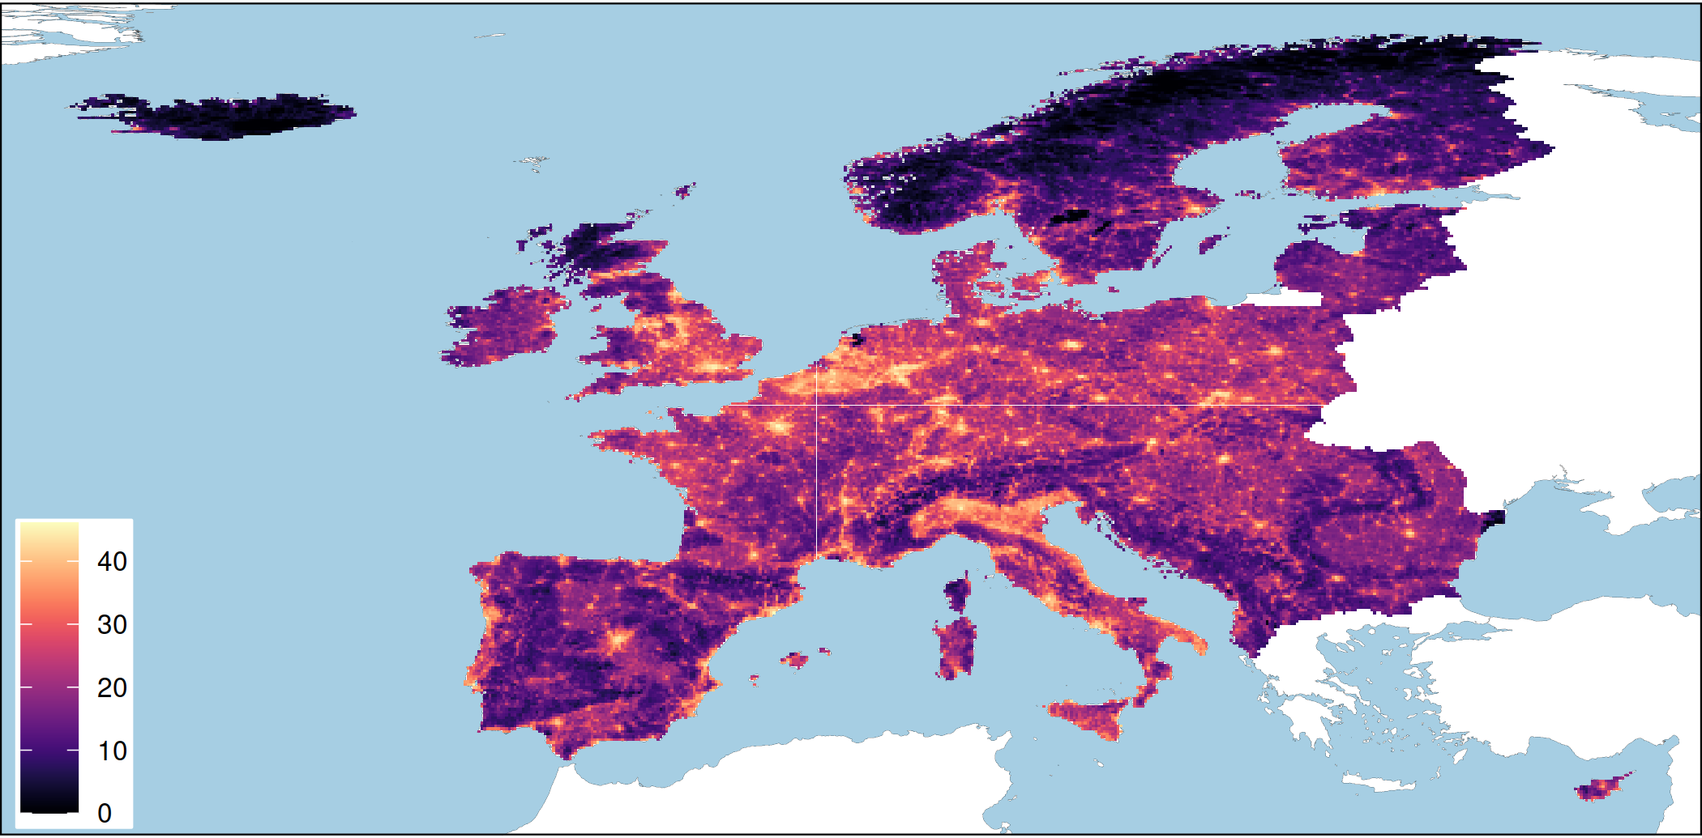
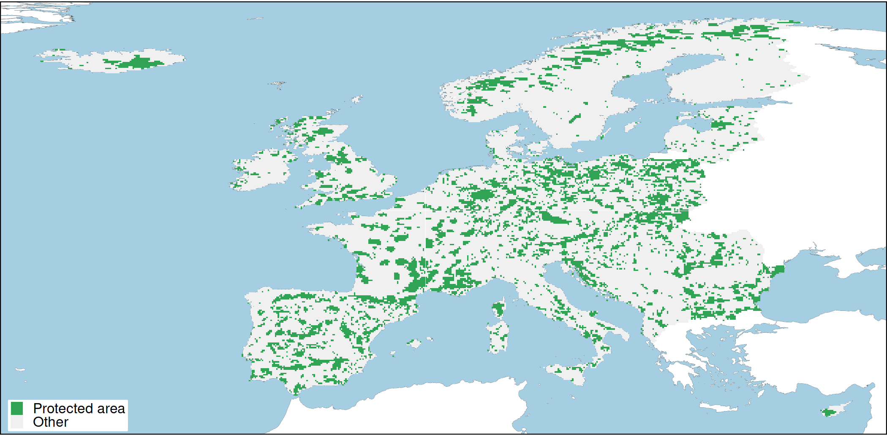
European case study
Majority of terrestrial vertebrate species
81 amphibian species
378 bird species
156 mammal species
95 reptile species
43 countries
10 × 10 km resolution planning units
Conservation benefit for a species = amount of threat-free habitat in conservation areas
Human pressure
Protected areas
Hanson et al. In prep

Slide 23
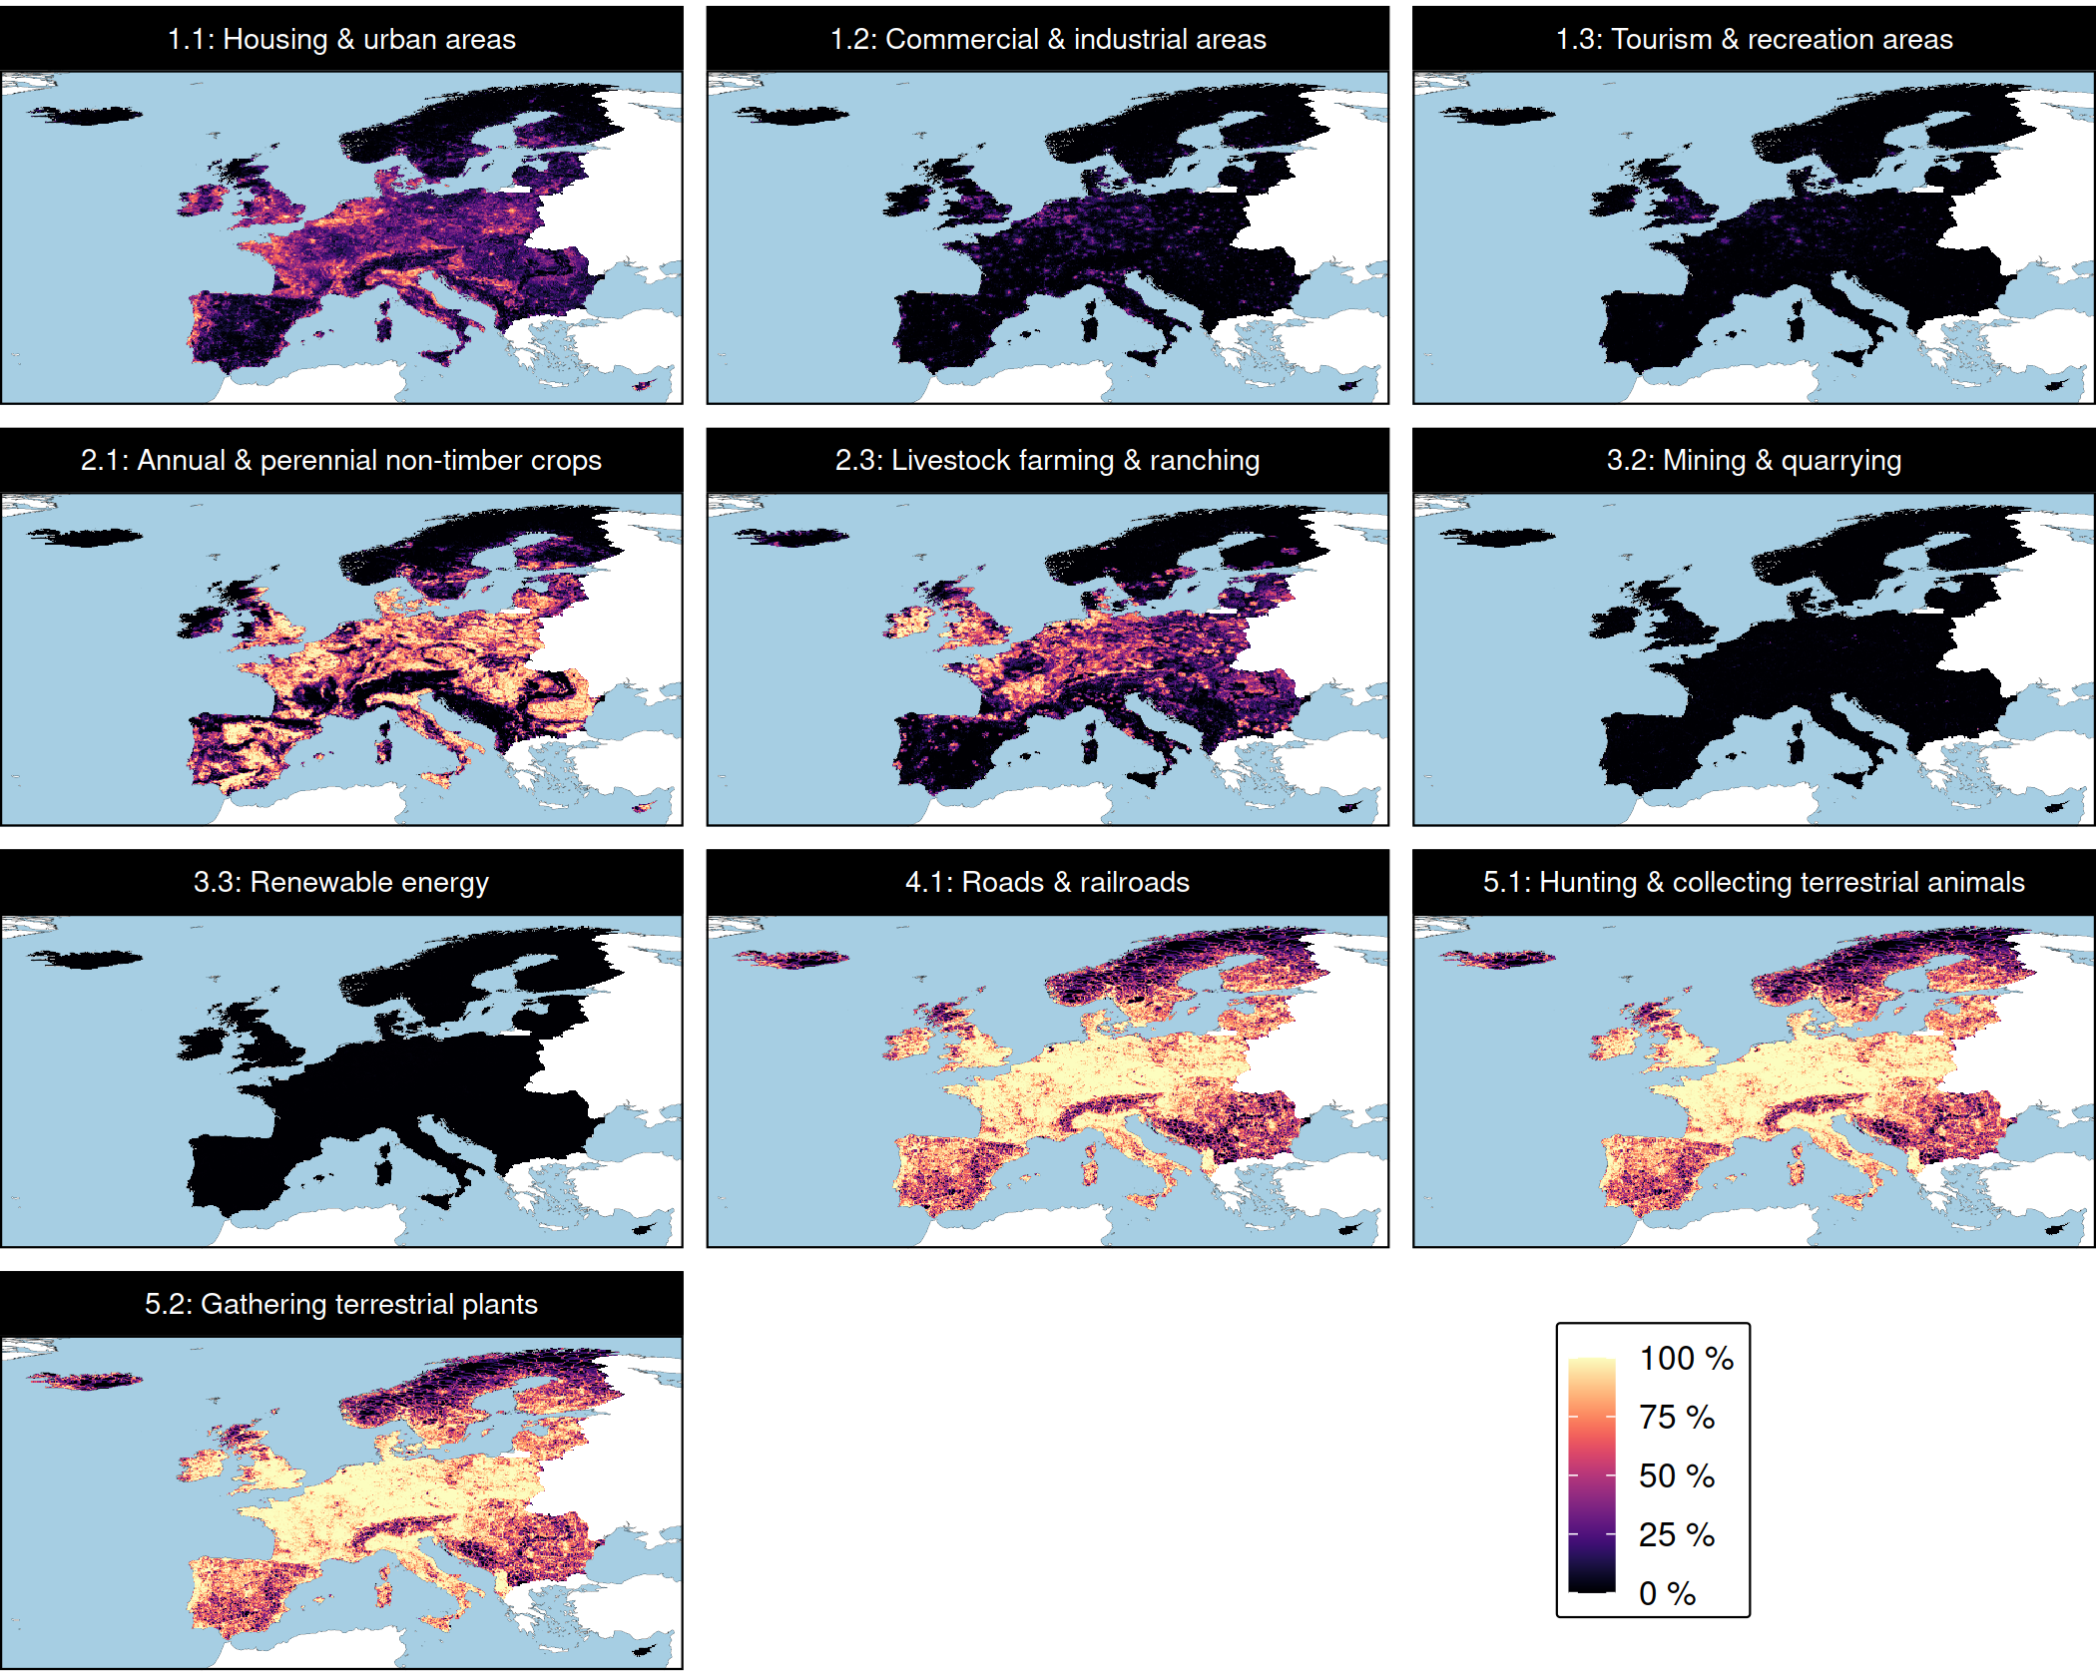
Threats
P
P
P = Permanent
R = Restoration
Management costs modelled using human footprint index as surrogate for opportunity costs
R
R
R
P
Hanson et al. In prep

Slide 24

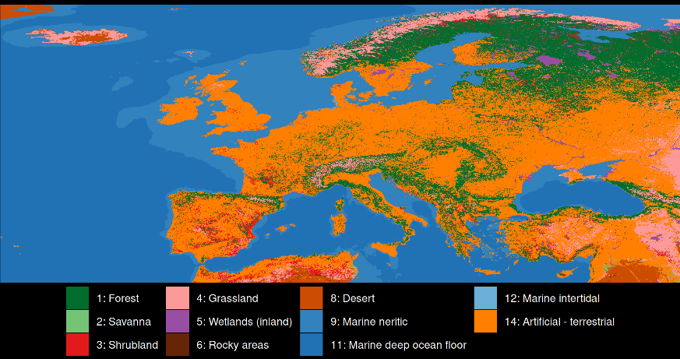
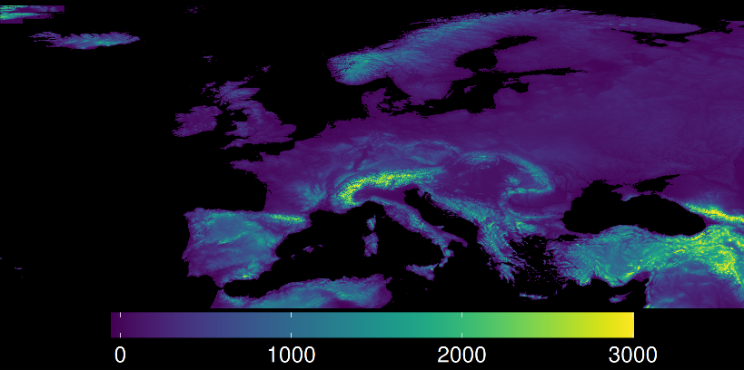
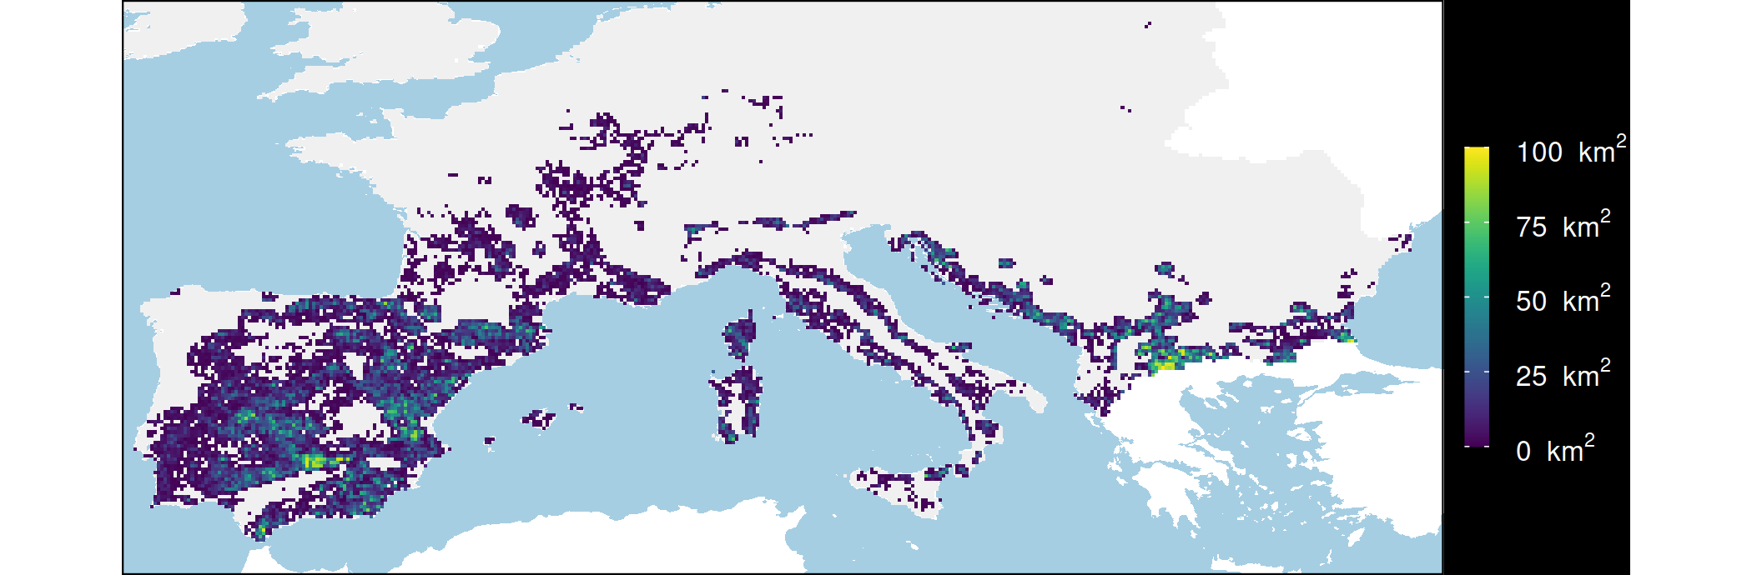
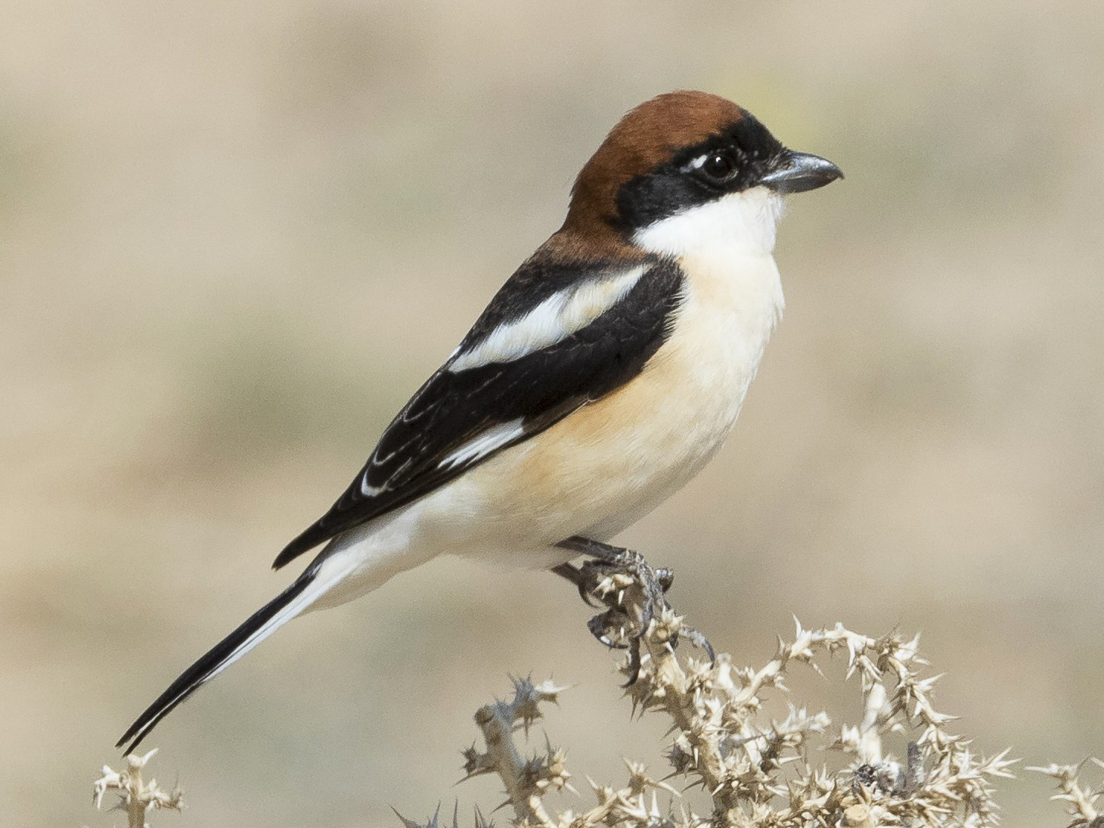
Mapping suitable habitat for species
Current land cover
Elevation
Threats
Species
habitat types
elevational limits
threat impacts
Woodchat Shrike
Area of threat-free habitat
Hanson et al. In prep

Slide 25



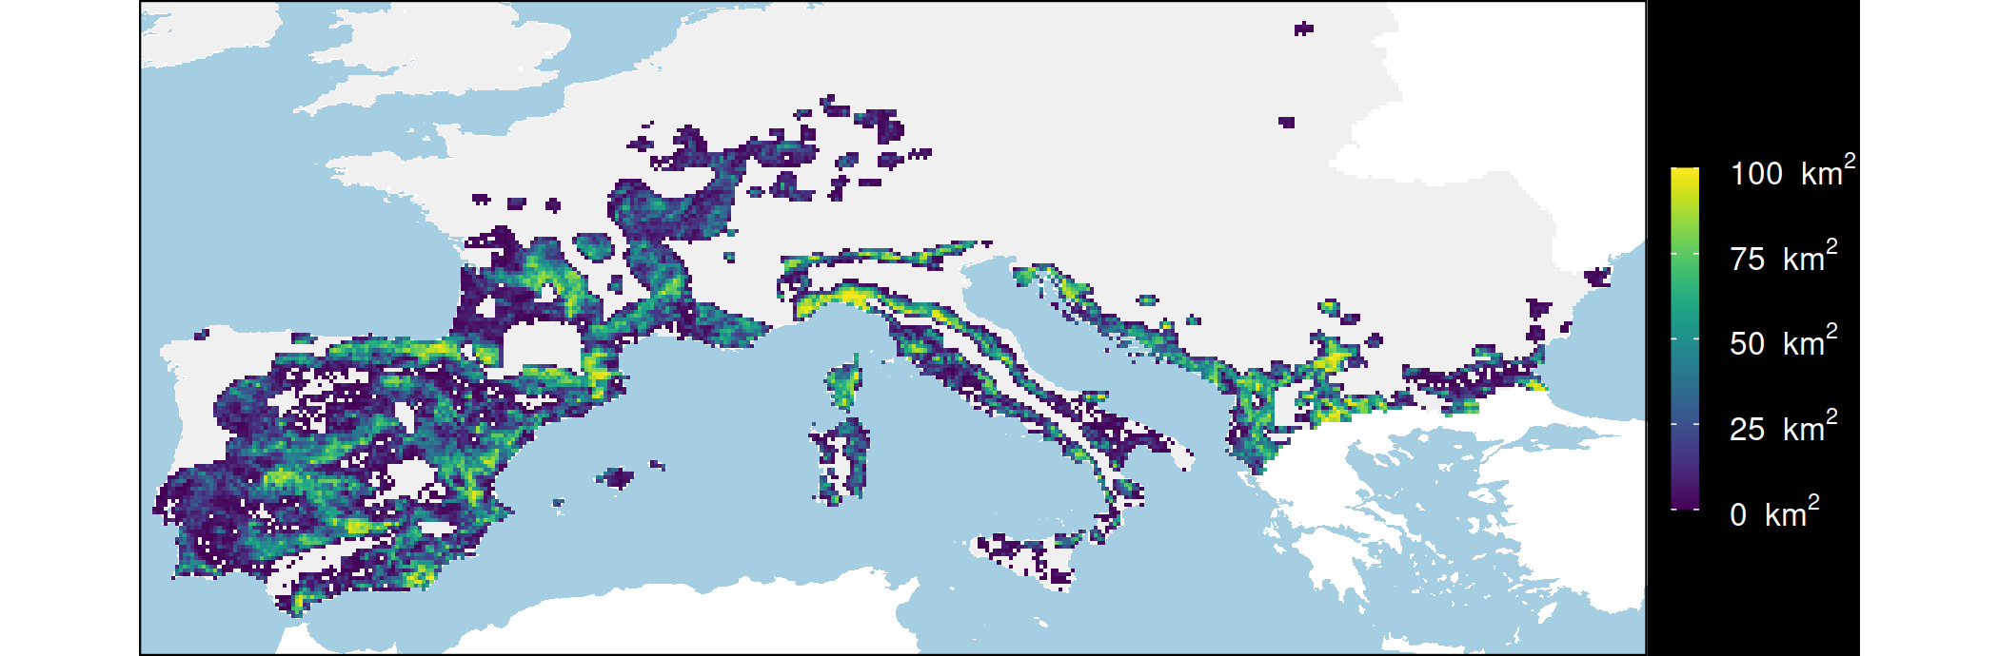
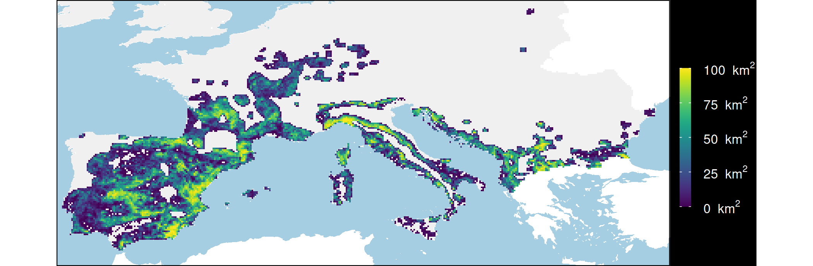

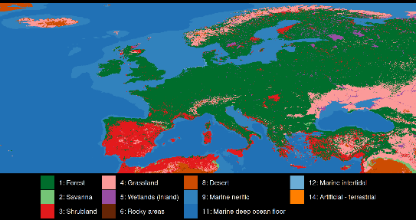
Mapping consequences of managing threats
Existing habitat
Species
Elevation
Woodchat Shrike
Restore croplands
Threats
What if?
Stop hunting
Current
land cover
Potential natural
vegetation
Restore croplands
& stop hunting
Hanson et al. In prep

Slide 26
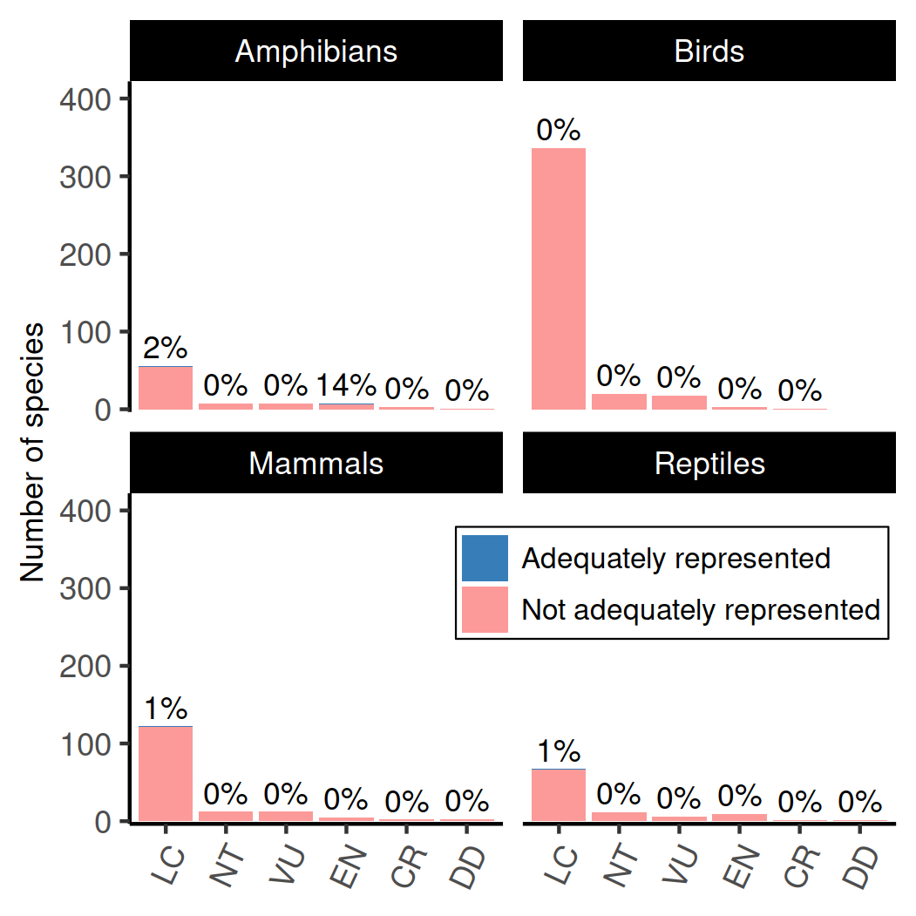
Existing protected areas
Four (0.56%) species adequately represented when accounting for threats
Only one of 74 critically endangered species adequately represented when accounting for threats
Hanson et al. In prep

Slide 27
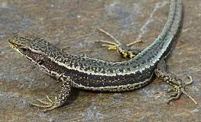

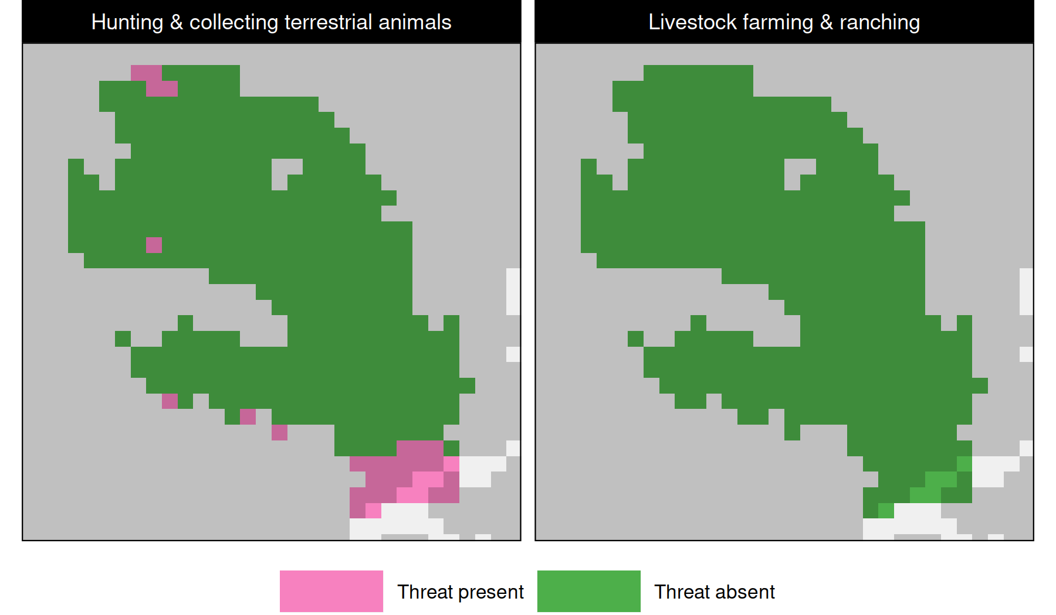
Aurelio's rock lizard (Iberolacerta aurelioi)
100% representation target, because very small current and potential area of habitat
We would normally think this species is adequately represented because 100% of its area of habit covered by protected areas
However, this species needs management across 8% of its potential area of habitat to meet the target
Hanson et al. In prep

Slide 28
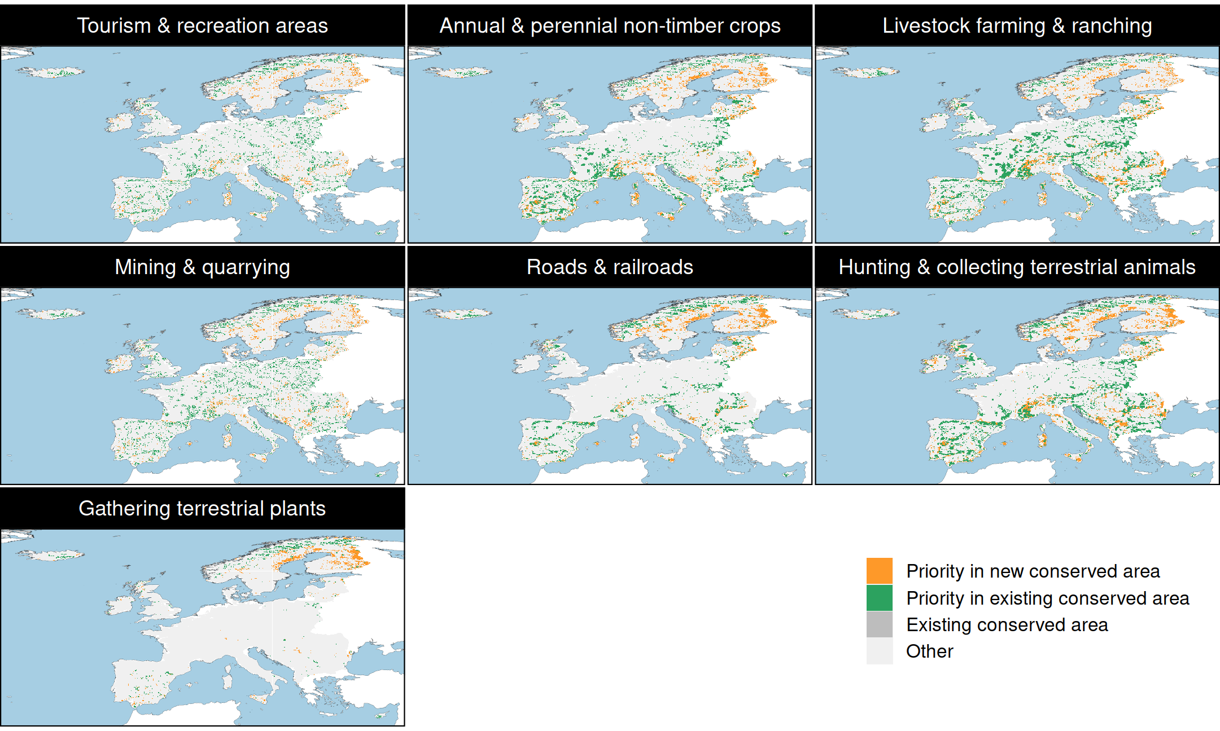
Prioritization to manage threats
12%
17%
22%
14%
11%
20%
3%
Hanson et al. In prep

Slide 29
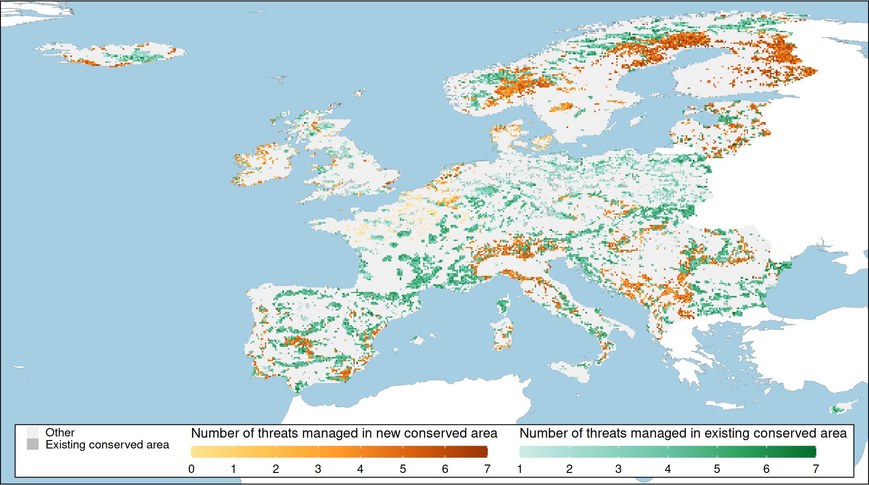
Patterns in management effort
Total area ≤ 30% of each country
Adequately represents 325 (45%) species
Hanson et al. In prep

Slide 30
Patterns in management effort
66% of priority areas managing inside existing conserved areas
32% of priority areas establishing new protected areas and managing threats
2% of priority areas simply protecting remnant habitat
Hanson et al. In prep

Slide 31
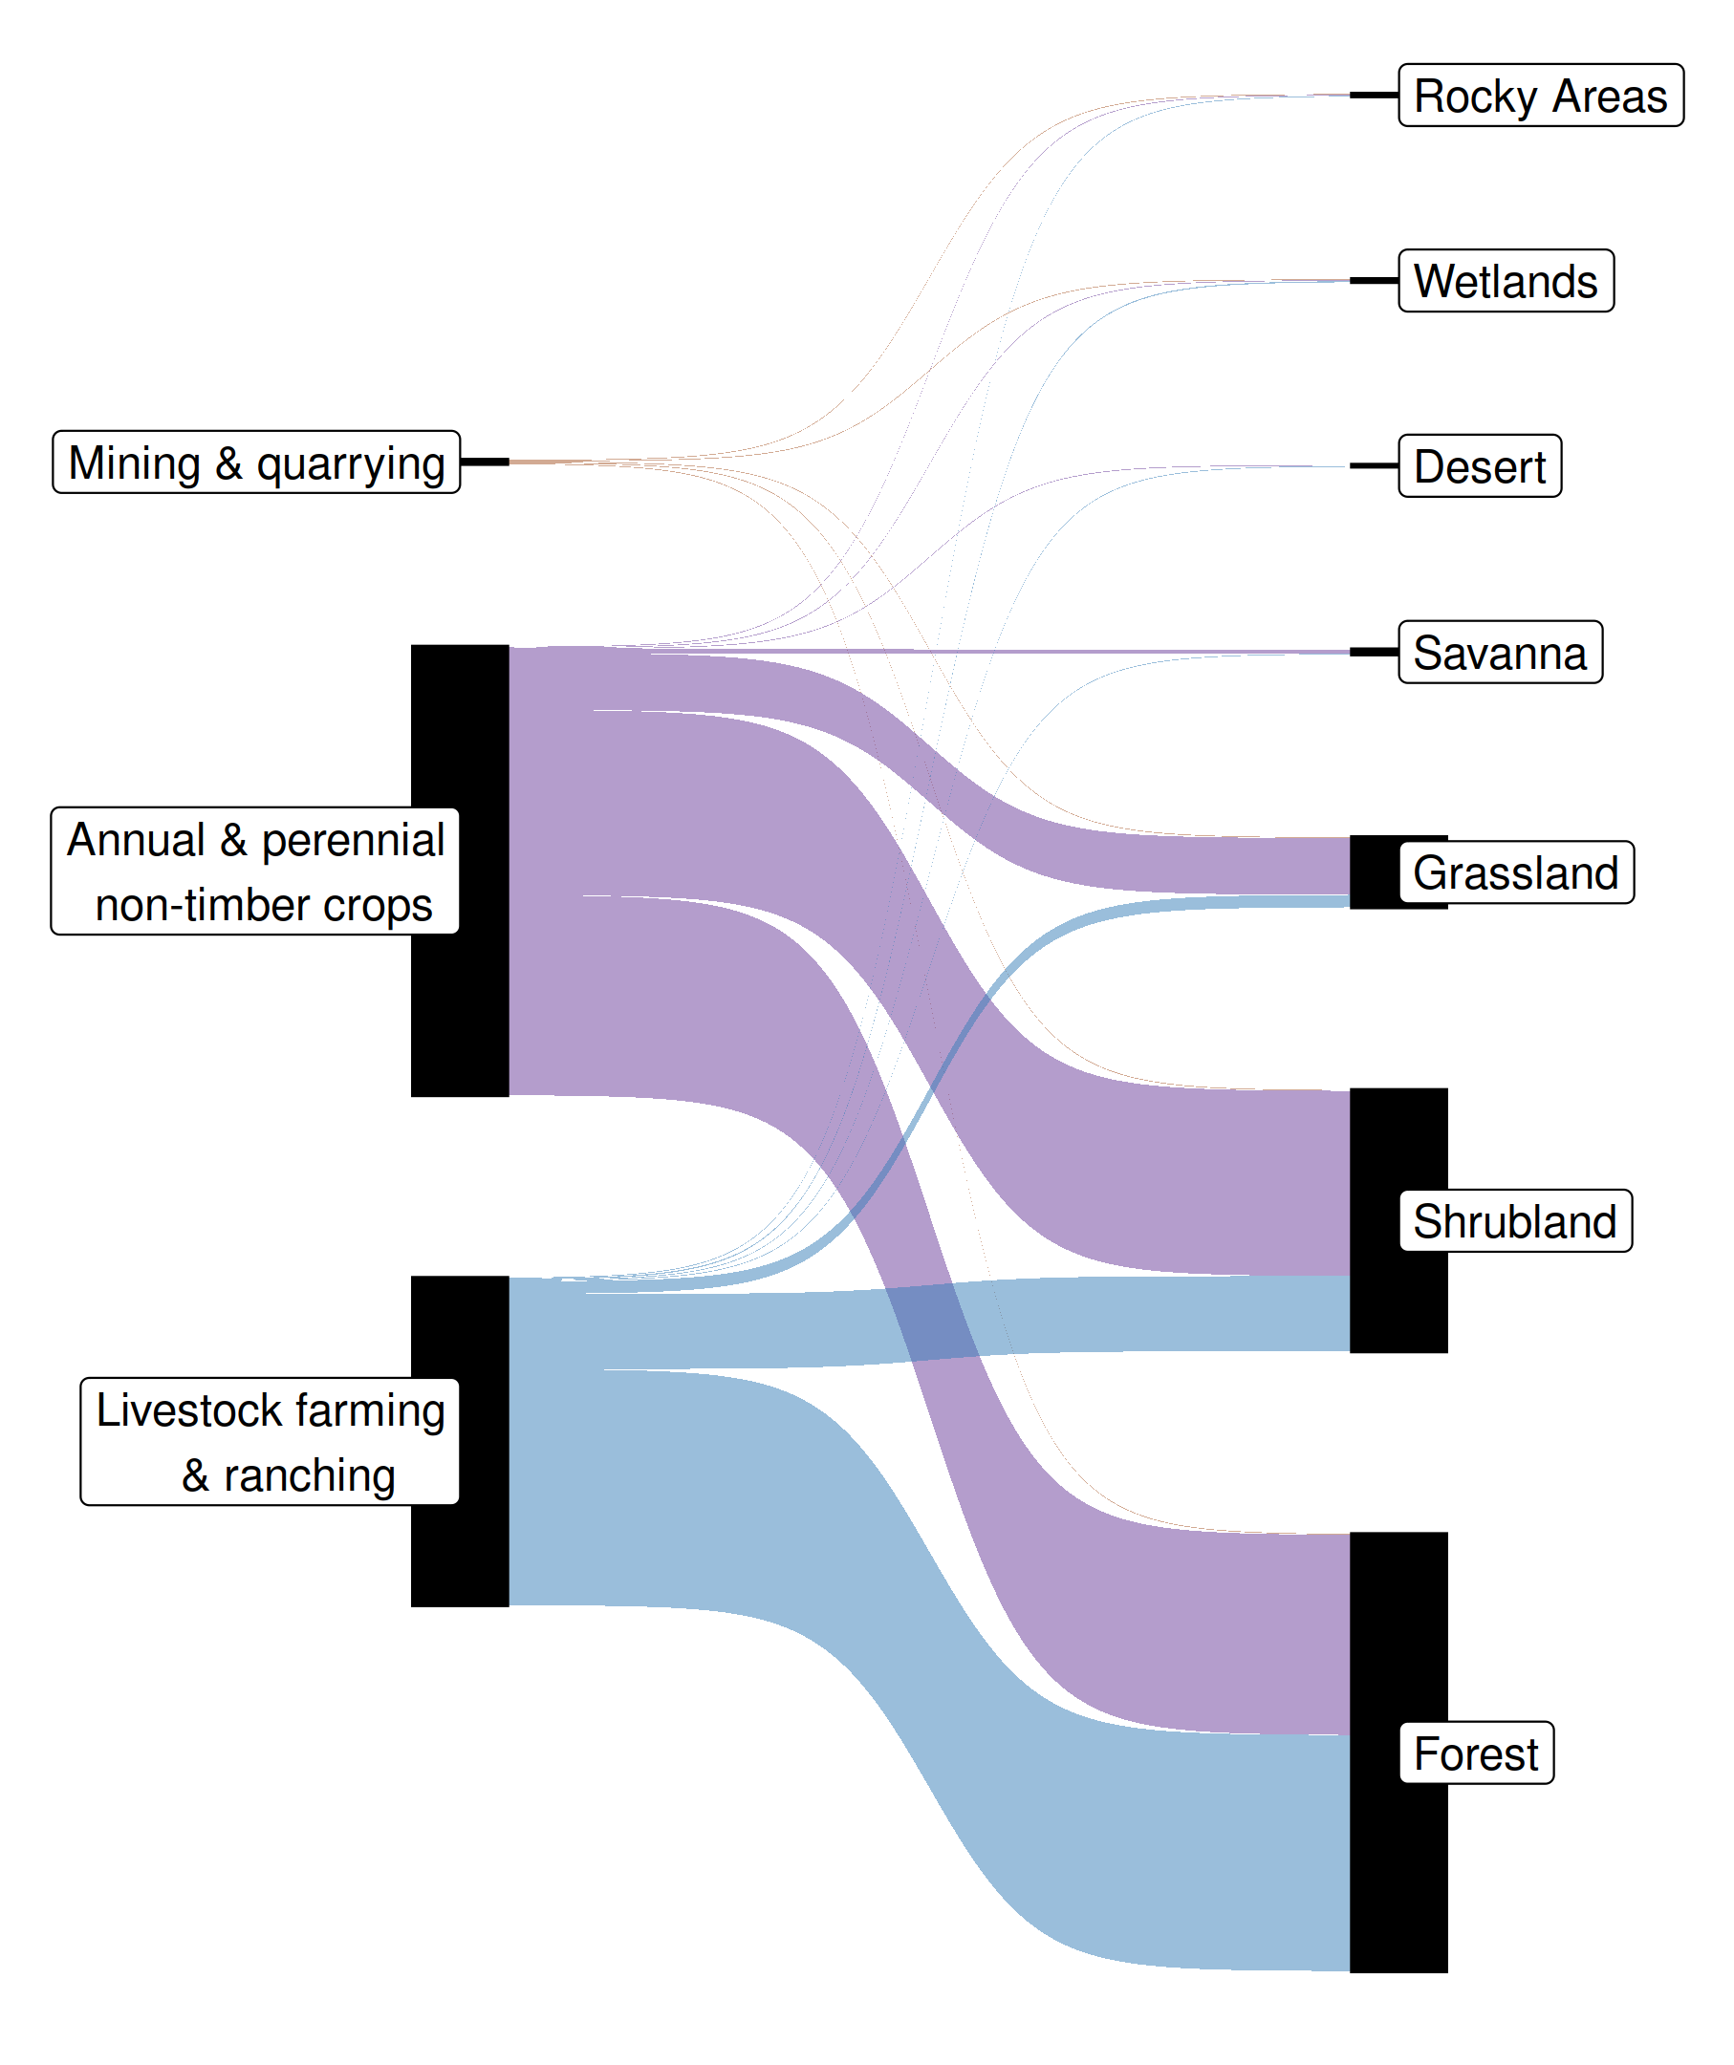
Habitat restoration
Of the 7 threats that could be managed, 3 associated with restoration actions
69% of priority areas involved restoring habitat inside protected areas
30% of priority areas involved restoring habitat in newly established protected areas
28% of Europe’s land prioritized for habitat restoration
EU pledged to restore 20%
Hanson et al. In prep

Slide 32
How can we get a better conservation decision?
(1) Better algorithms
(2) Better data
(3) Better surrogates

Slide 33
Ecological surveys
Distribution maps
Priority areas
Biodiversity
2000
Future
Data
Information
Plan
Outcome
Objectives
Constraints

Slide 34
Ecological surveys
Distribution maps
Priority areas
Biodiversity
?
?
?
?
?
?
2000
Future
Data
Information
Plan
Outcome
More
surveys
Better
models
Better
management
Better
outcome
Objectives
Constraints

Slide 35
Ecological surveys
Distribution maps
Priority areas
Biodiversity
?
?
?
?
?
?
?
?
?
?
?
?
2000
Future
Data
Information
Plan
Outcome
More
surveys
Better
models
Poorer
management
Worse
outcome
Objectives
Constraints
Less funding

Slide 36
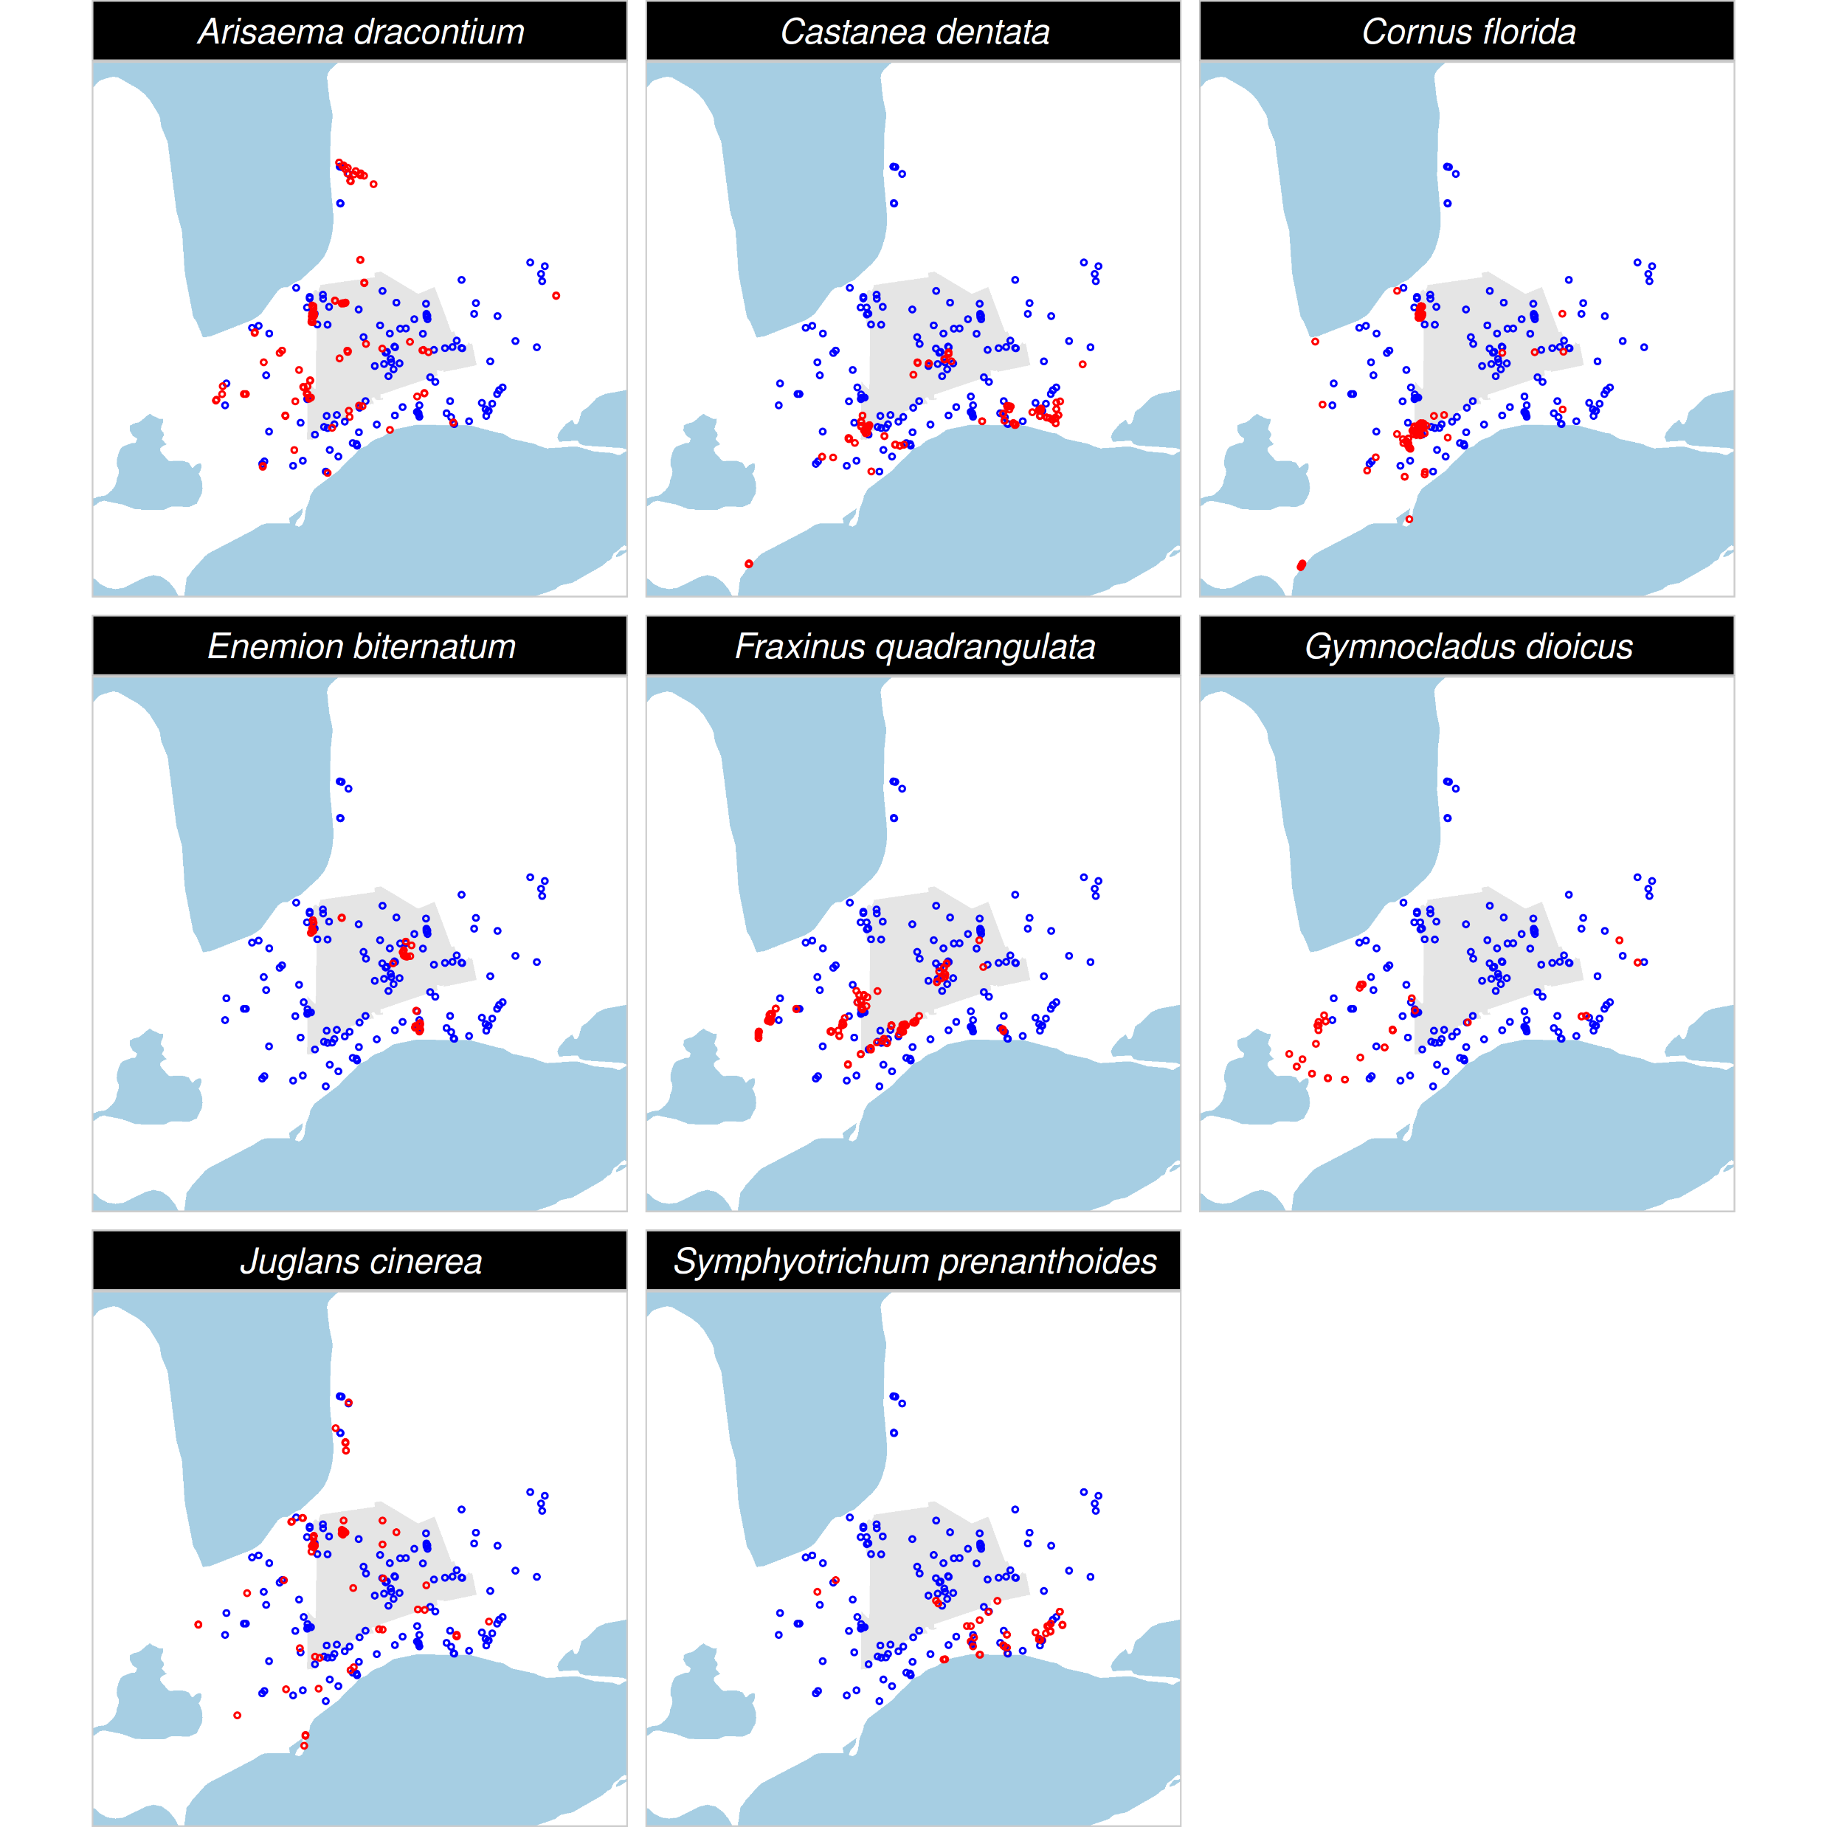
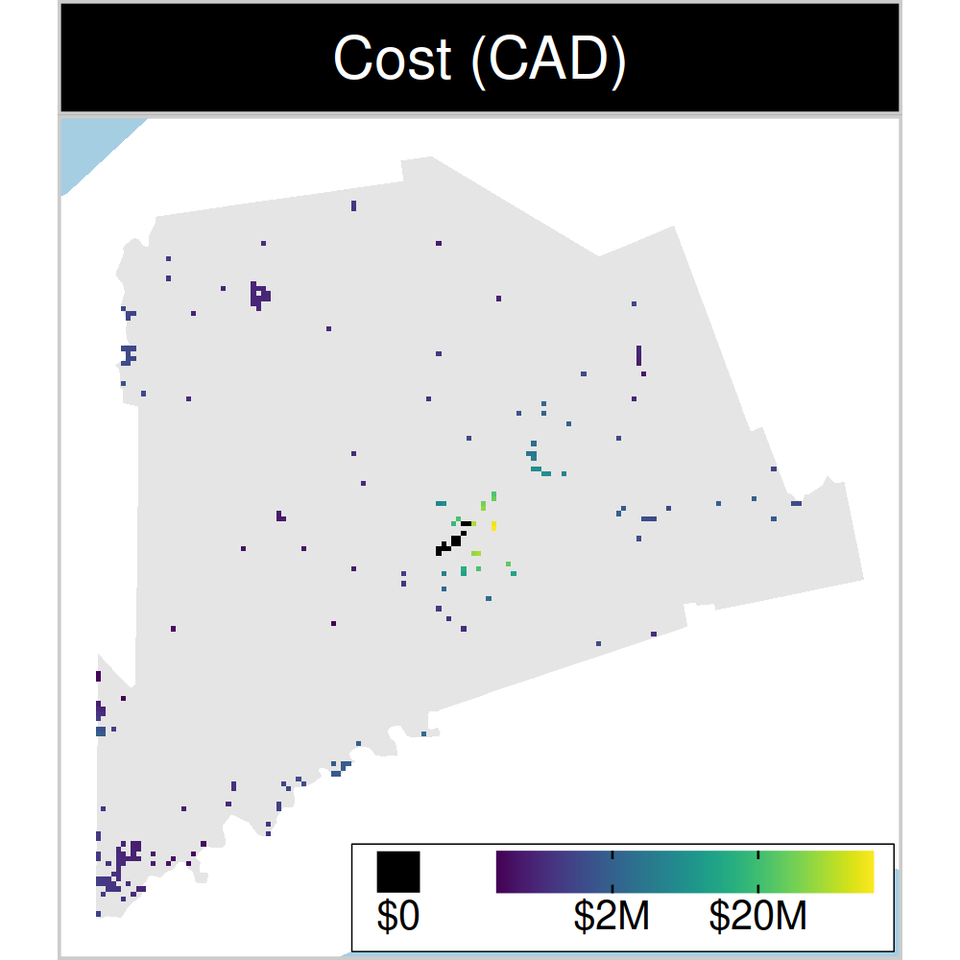
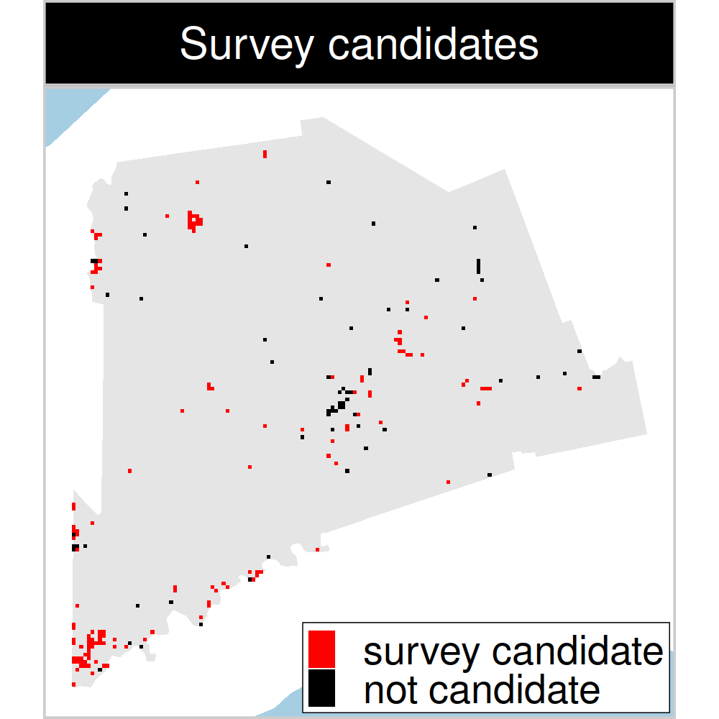
Study system: Middlesex county, Canada
199 places that could
potentially be acquired for
protected area establishment
143 places that could potentially be surveyed to
improve existing data
8 imperiled plant species
Hanson et al. 2023 J. Appl. Ecol
Notes:
36

Slide 37
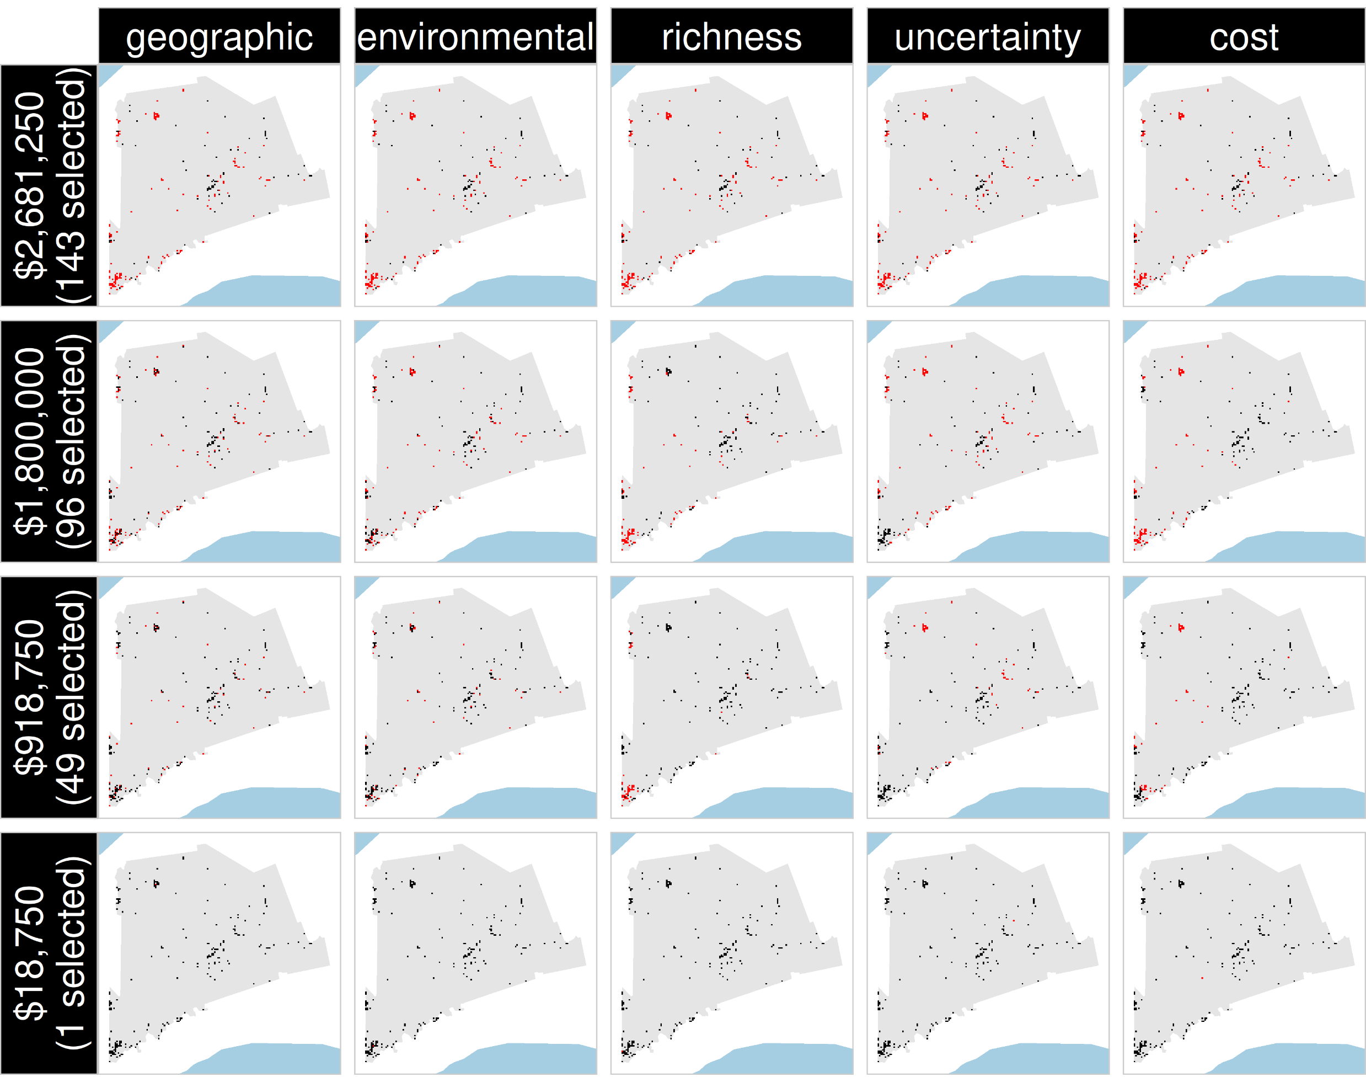
Selected
for survey
Number of places selected for surveys
(amount of funds allocated for collecting extra data)
NOT selected
for survey
Different approaches for designing survey schemes
Hanson et al. 2023 J. Appl. Ecol

Slide 38
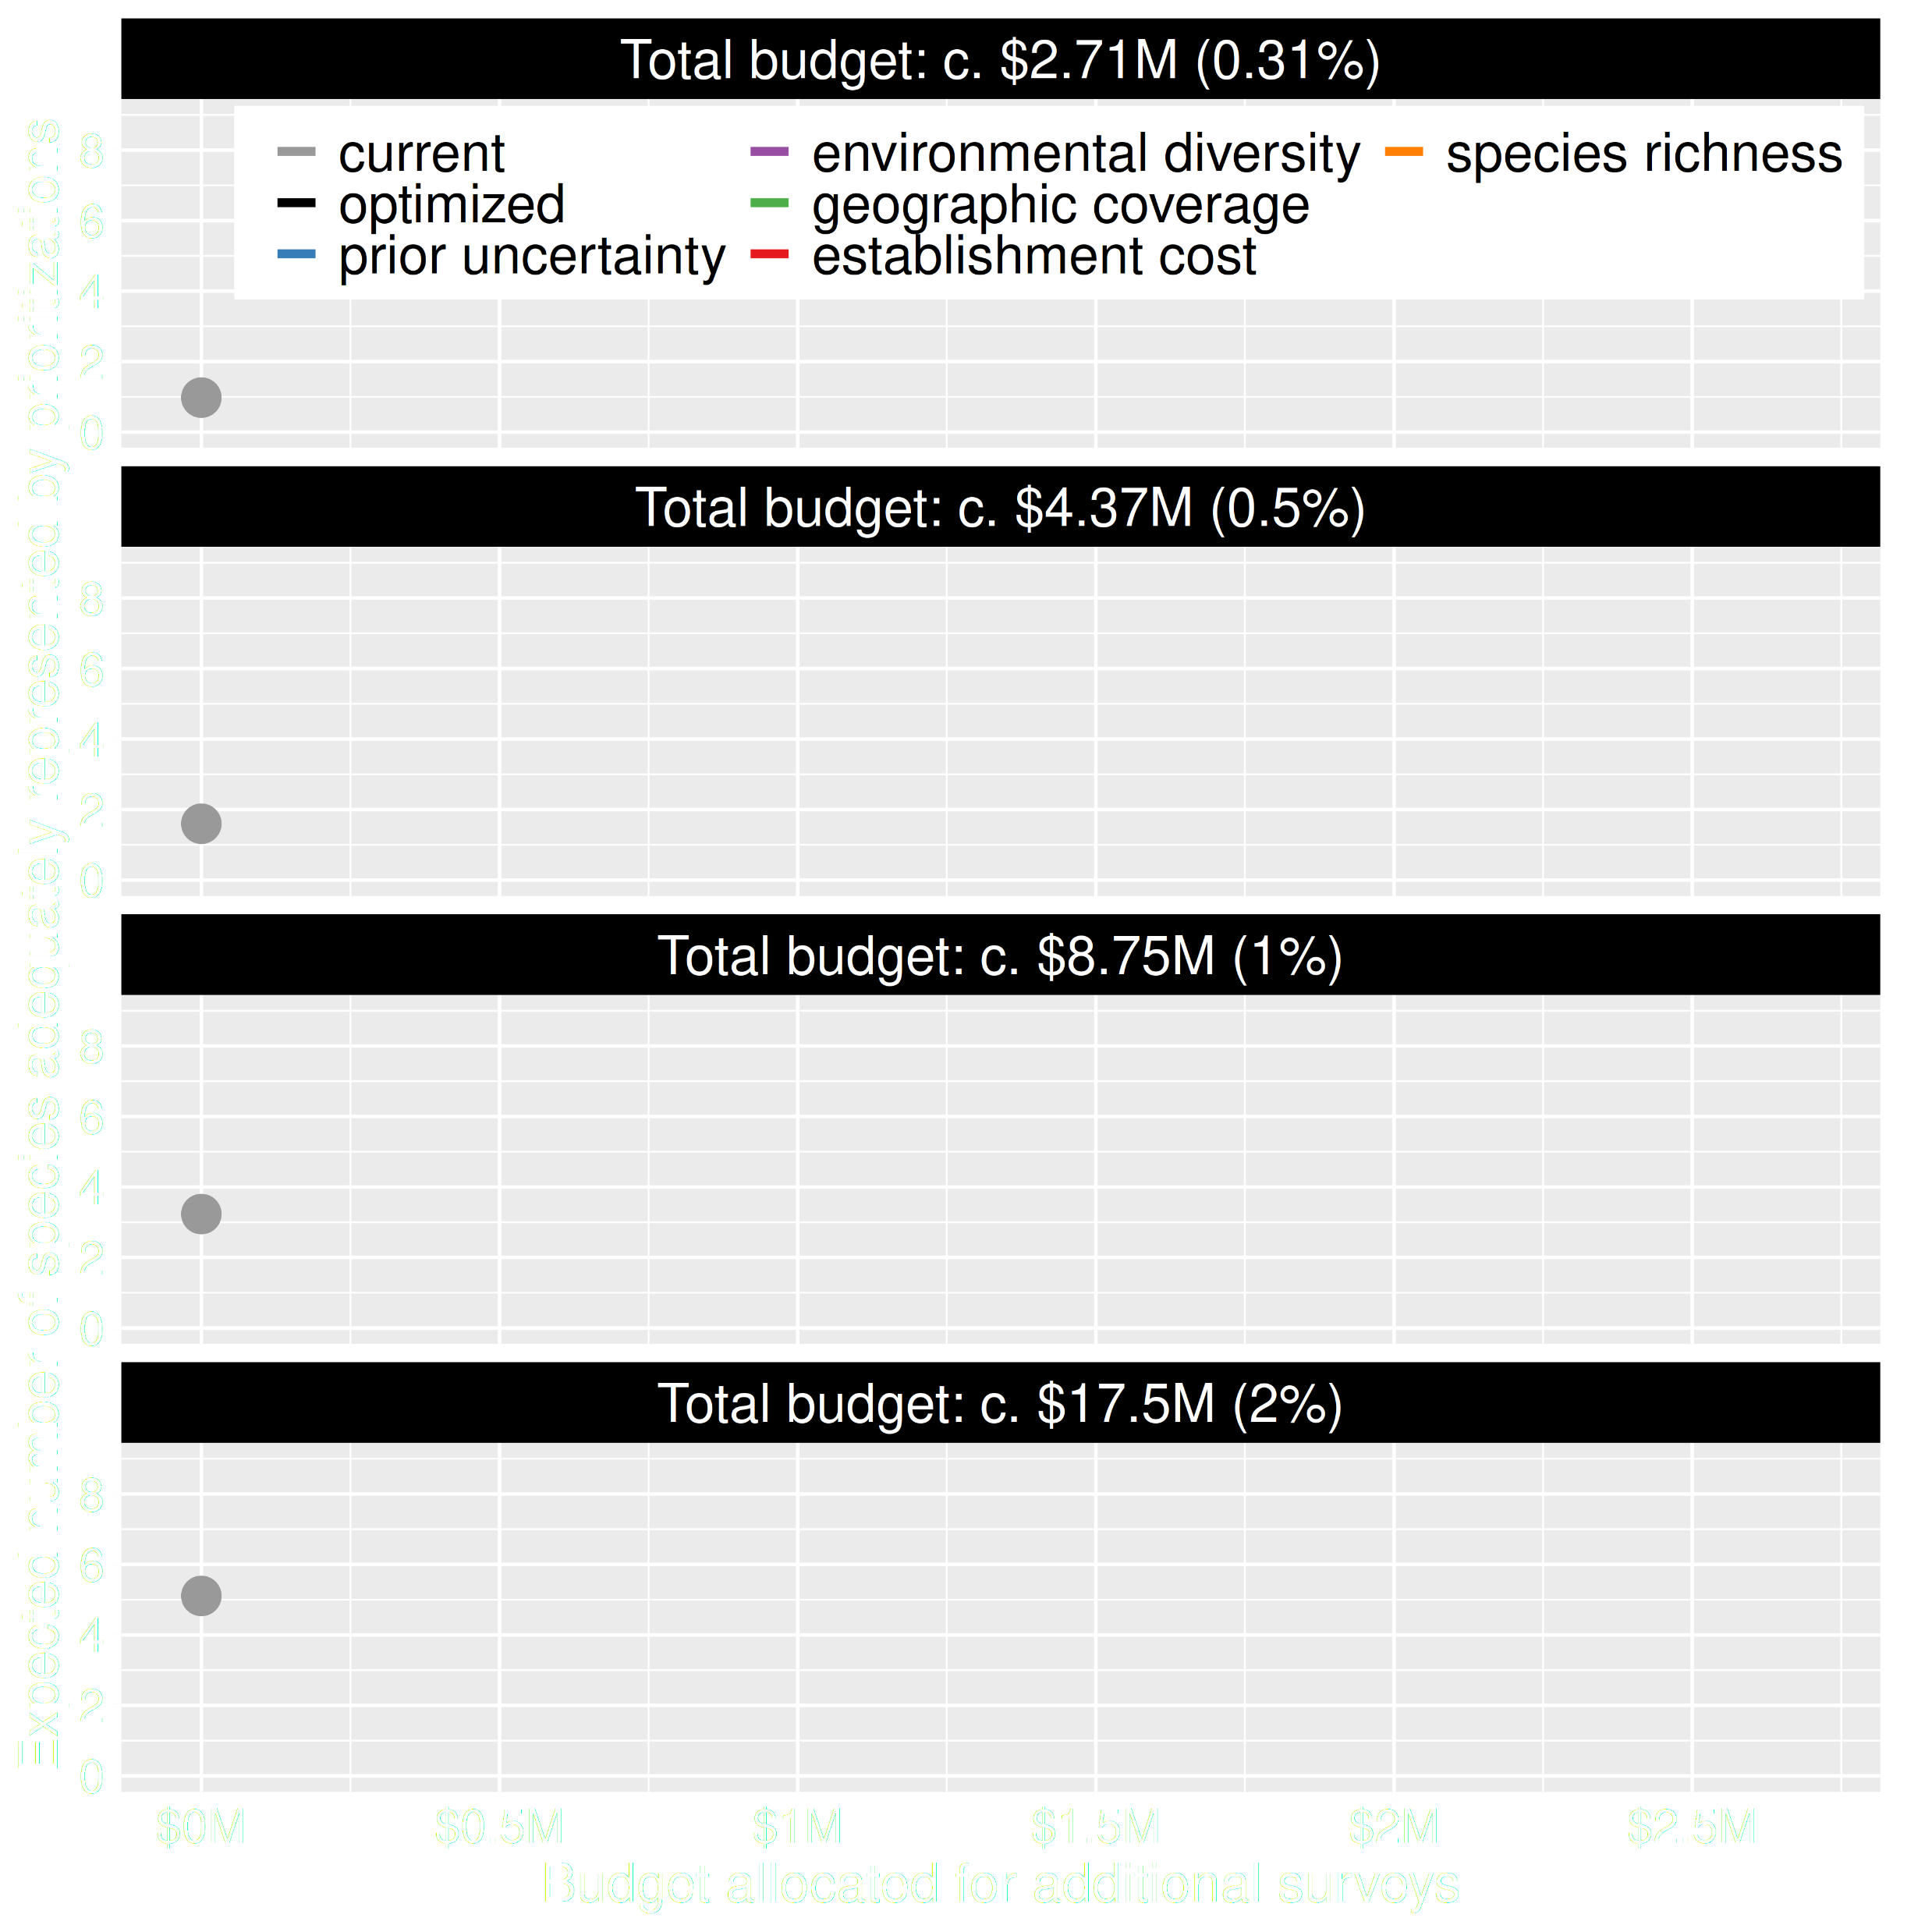
Value of information
Existing data leads to positive outcomes
More budget means better outcomes
Hanson et al. 2023 J. Appl. Ecol

Slide 39
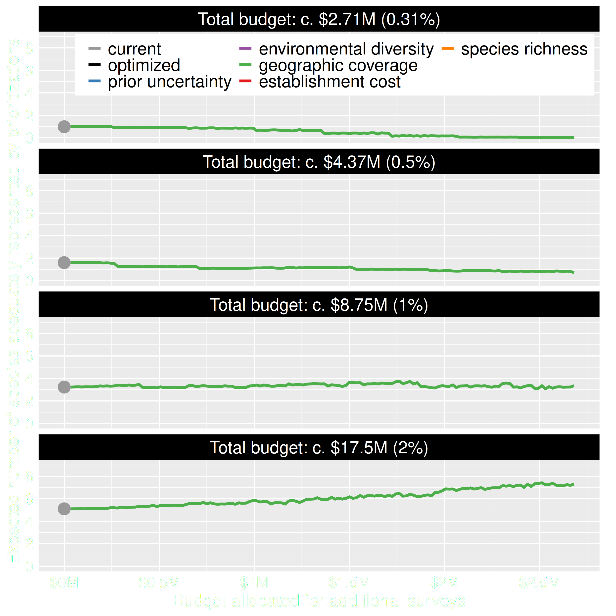
Value of information
Allocating funds for gathering more data can mean worse outcomes
Allocating funds for gathering more data can mean better outcomes too
Hanson et al. 2023 J. Appl. Ecol

Slide 40
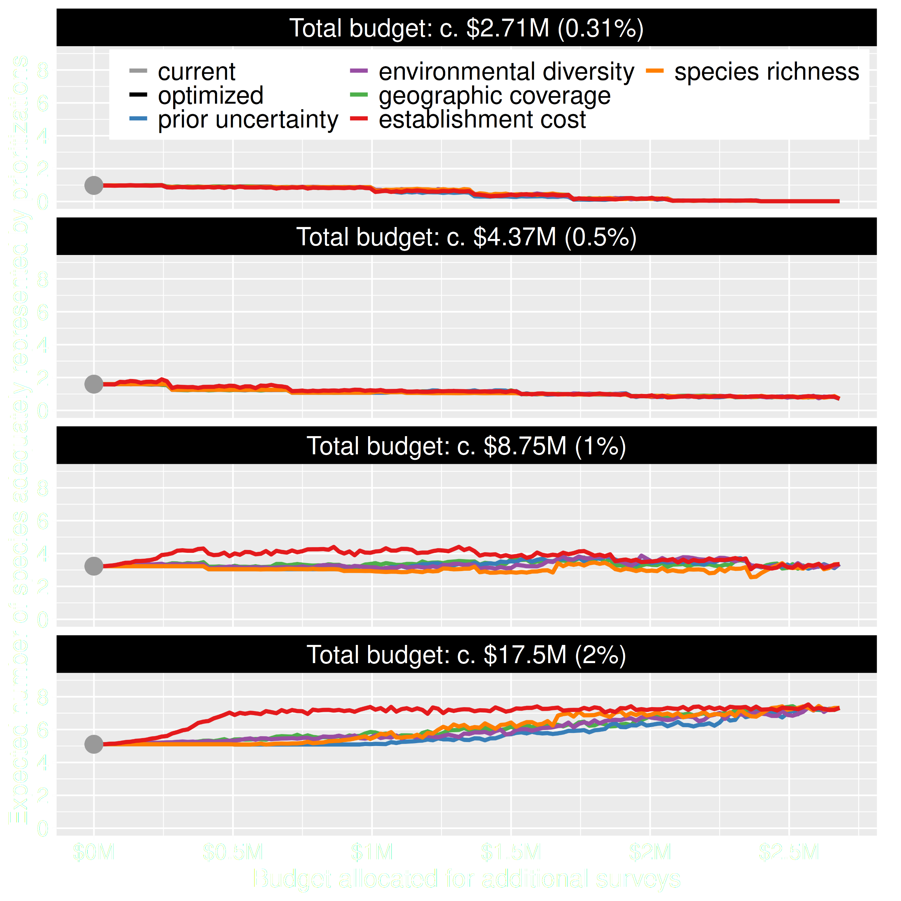
Value of information
Conventional approaches for gathering additional evidence have different performance
Performance of these approaches depends on available funds
All of them could lead to lead to worse outcomes
Hanson et al. 2023 J. Appl. Ecol

Slide 41
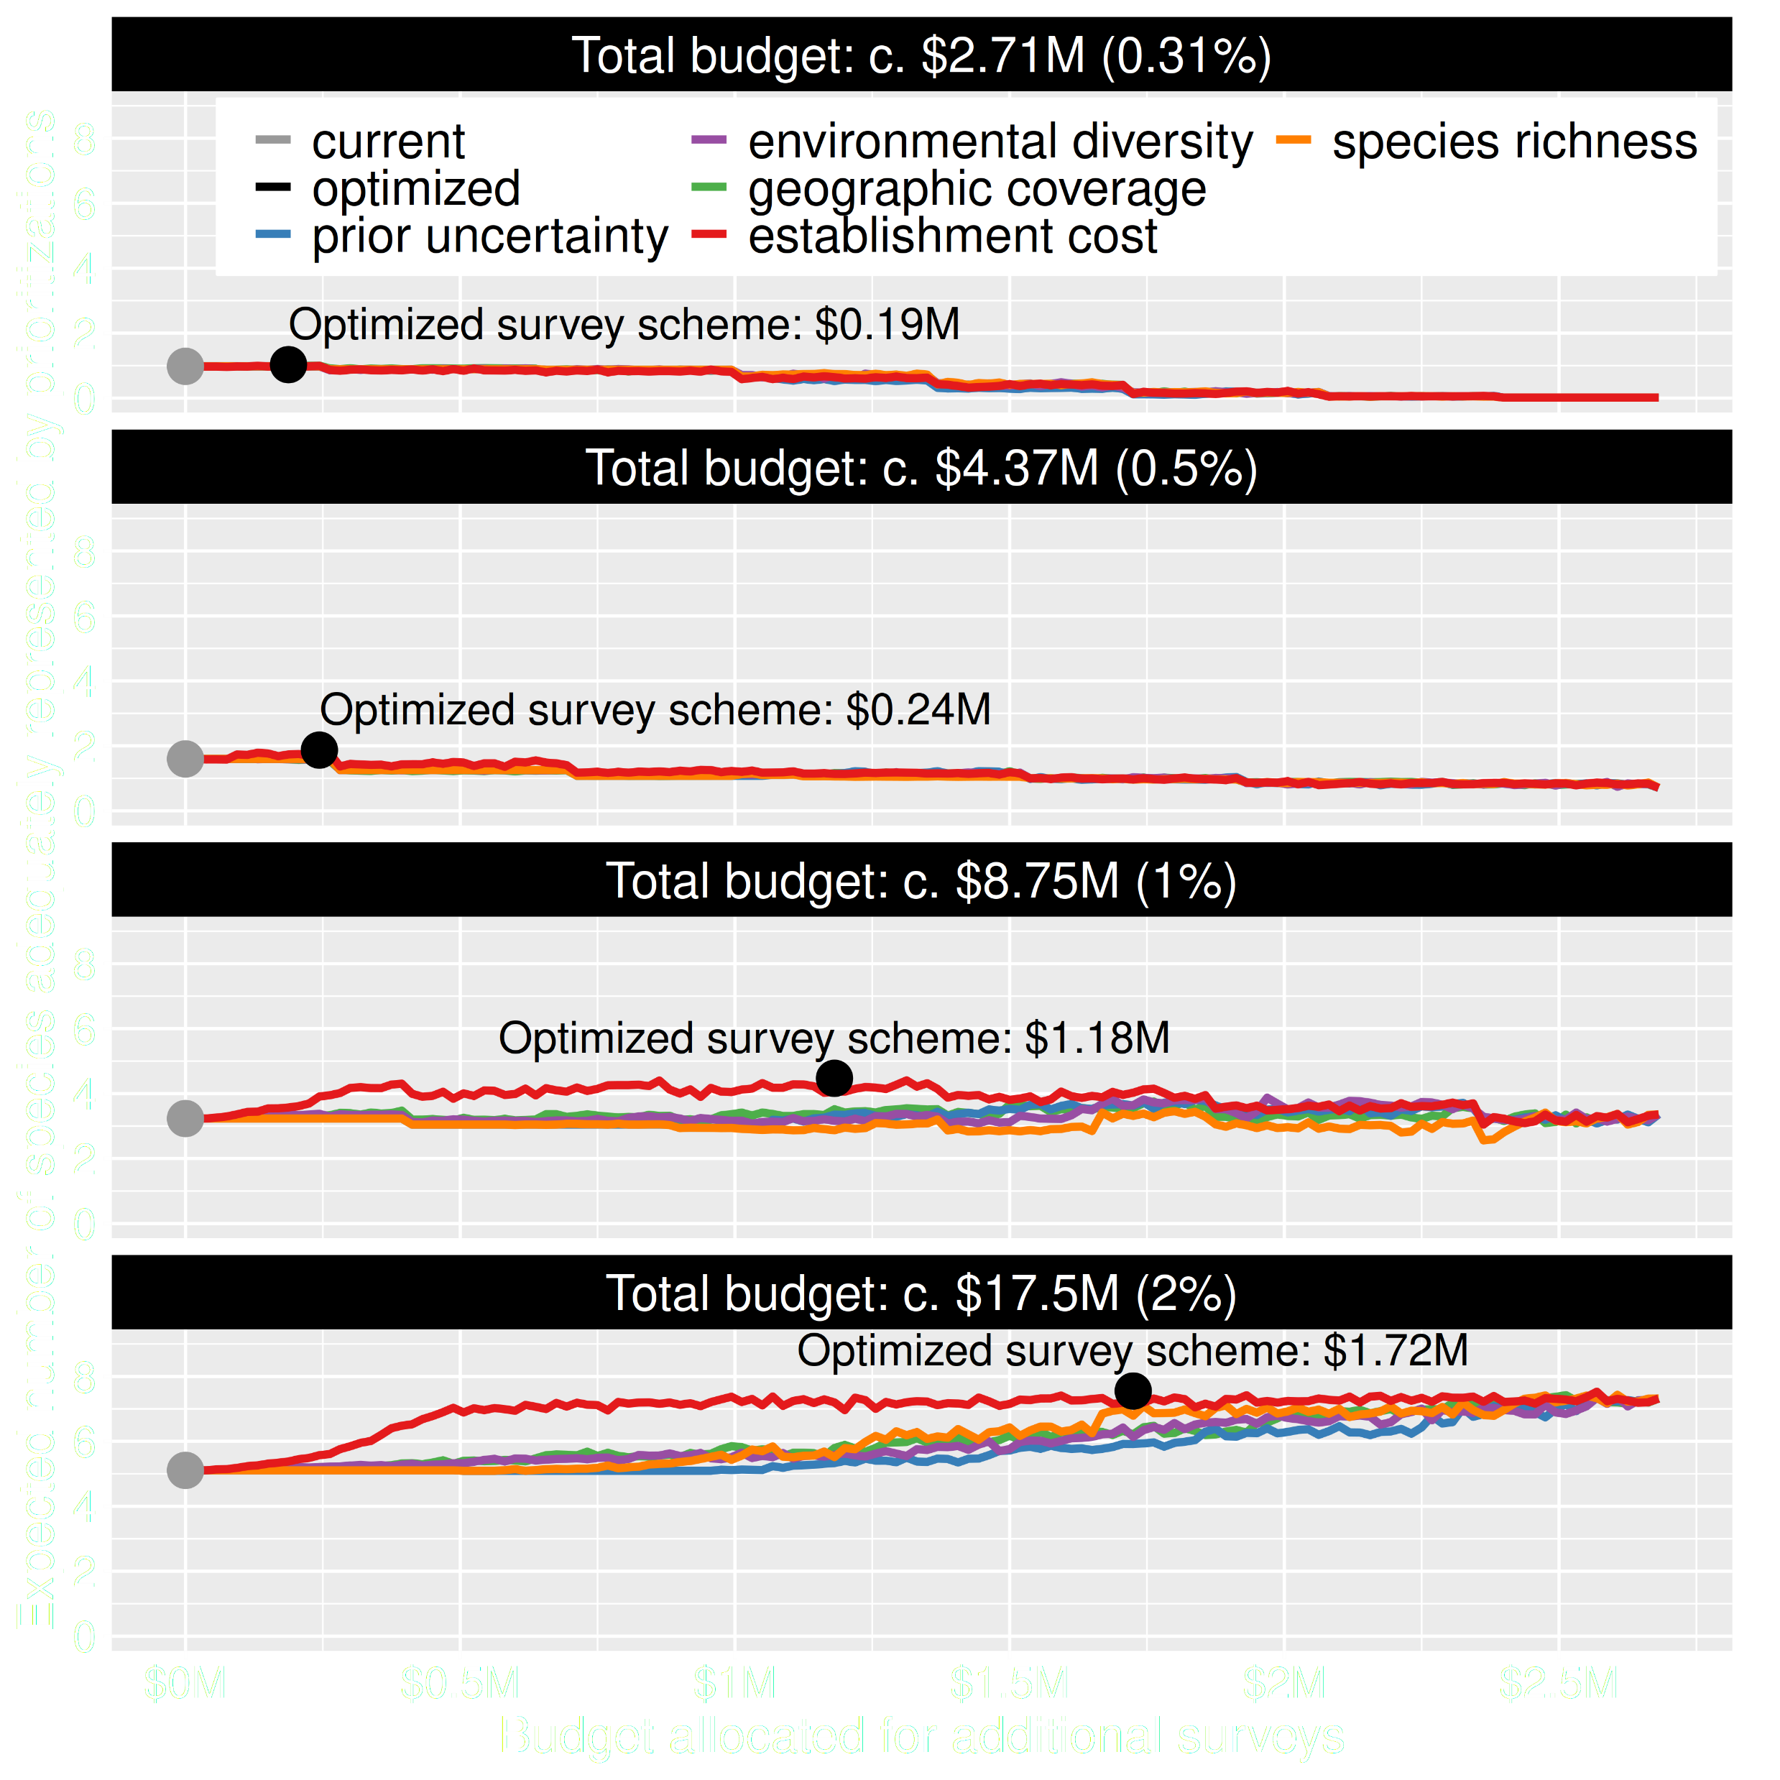
Value of information
Directly maximizing return on investment is best method for additional data
This considers objectives and constraints that underpin conservation plans and their success
You can do this with: surveyvoi R package
Hanson et al. 2023 J. Appl. Ecol

Slide 42
How can we get a better conservation decision?
(1) Better algorithms
(2) Better data
(3) Better surrogates

Slide 43
Ecological surveys
Distribution maps
Priority areas
Biodiversity
2000
Future
Data
Information
Plan
Outcome
Objectives
Constraints

Slide 44



Connectivity in reserve design
movement of individuals and genes between populations
*all else being equal

Slide 45
Data
Information
Plan
Outcome
Ecological surveys
Distribution maps
Priority areas
Biodiversity
2000
Future
Telemetry
Connectivity

Slide 46
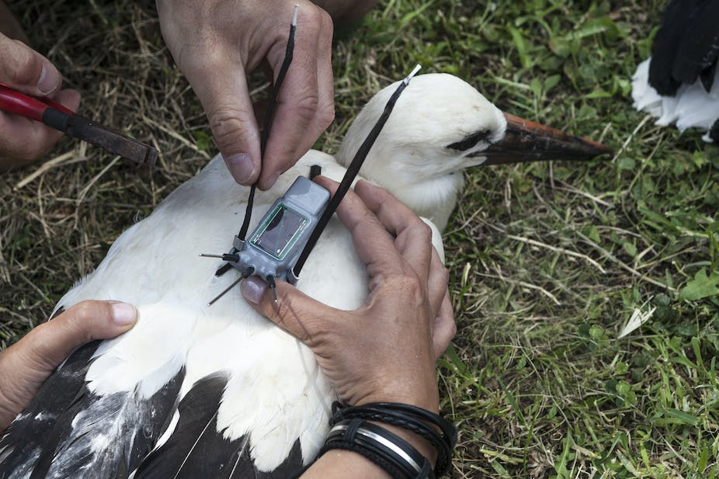
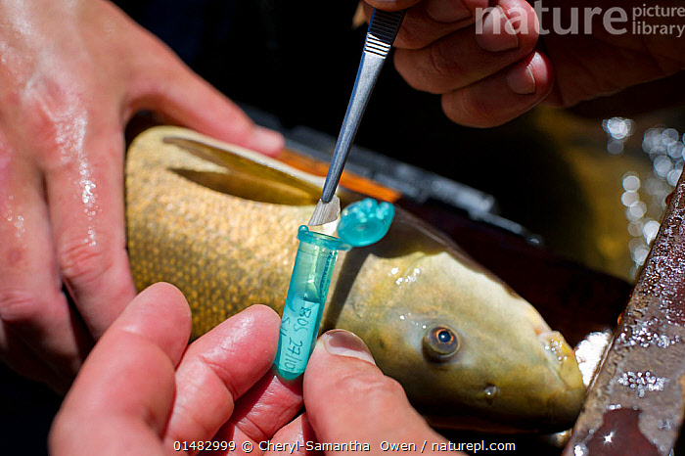
But getting connectivity data is hard
Animal telemetry
Molecular ecology

Slide 47

Data
Information
Plan
Outcome
Ecological surveys
Distribution maps
Priority areas
Biodiversity
2000
Future
Surrogate
Surrogate
High connectivity
Low connectivity

Slide 48
Many surrogates are often available,
how do our choices
affect the results?

Slide 49
Rules of thumb for connectivity
More habitat = More connectivity
Total area protected
Species representation
Now
Soon
Later

Slide 50
Rules of thumb for connectivity
More spatial clustering = More connectivity
Boundary length

Slide 51
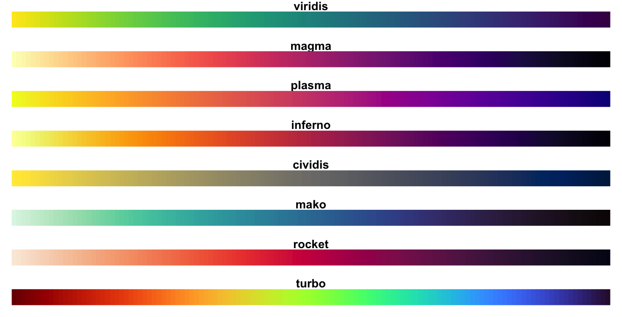
Rules of thumb for connectivity
Protect clusters of low resistance = More connectivity
Human pressure
Naturalness based landscape resistance
Focal species landscape resistance
Habitat heterogeneity
Environmental similarity
High resistance
Low resistance

Slide 52
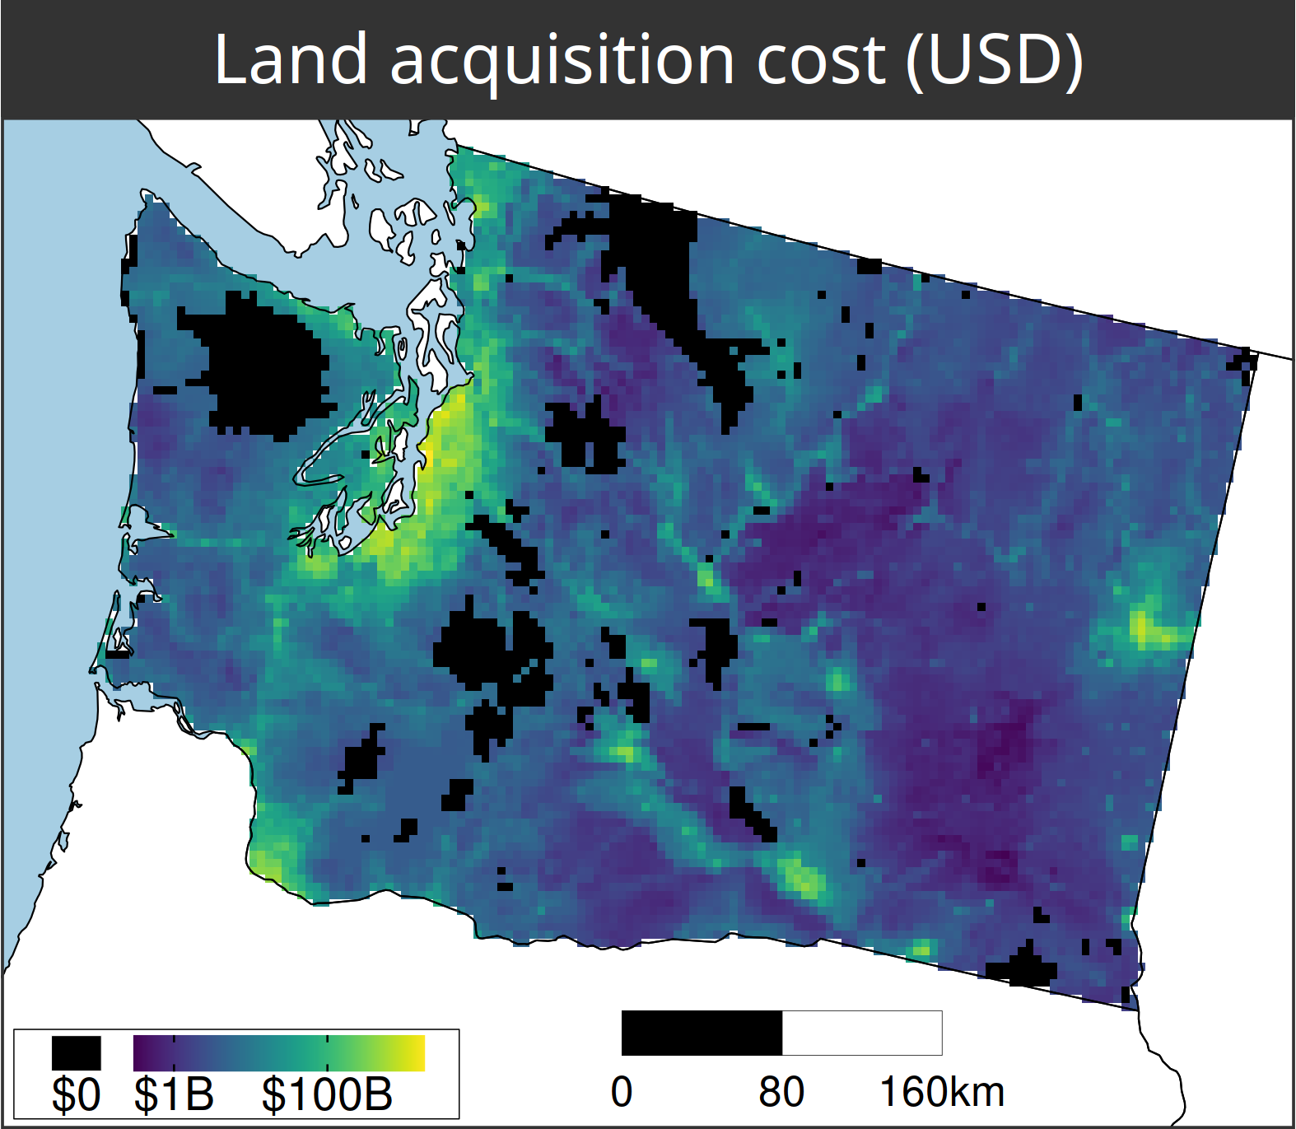
A comparison of approaches for including connectivity in systematic conservation planning
Washington State, USA
261 bird species
Land acquisition costs
Existing protected areas
Multiple land-uses
Multiple eco-systems
Hanson et al. 2022 J. Appl. Ecol

Slide 53
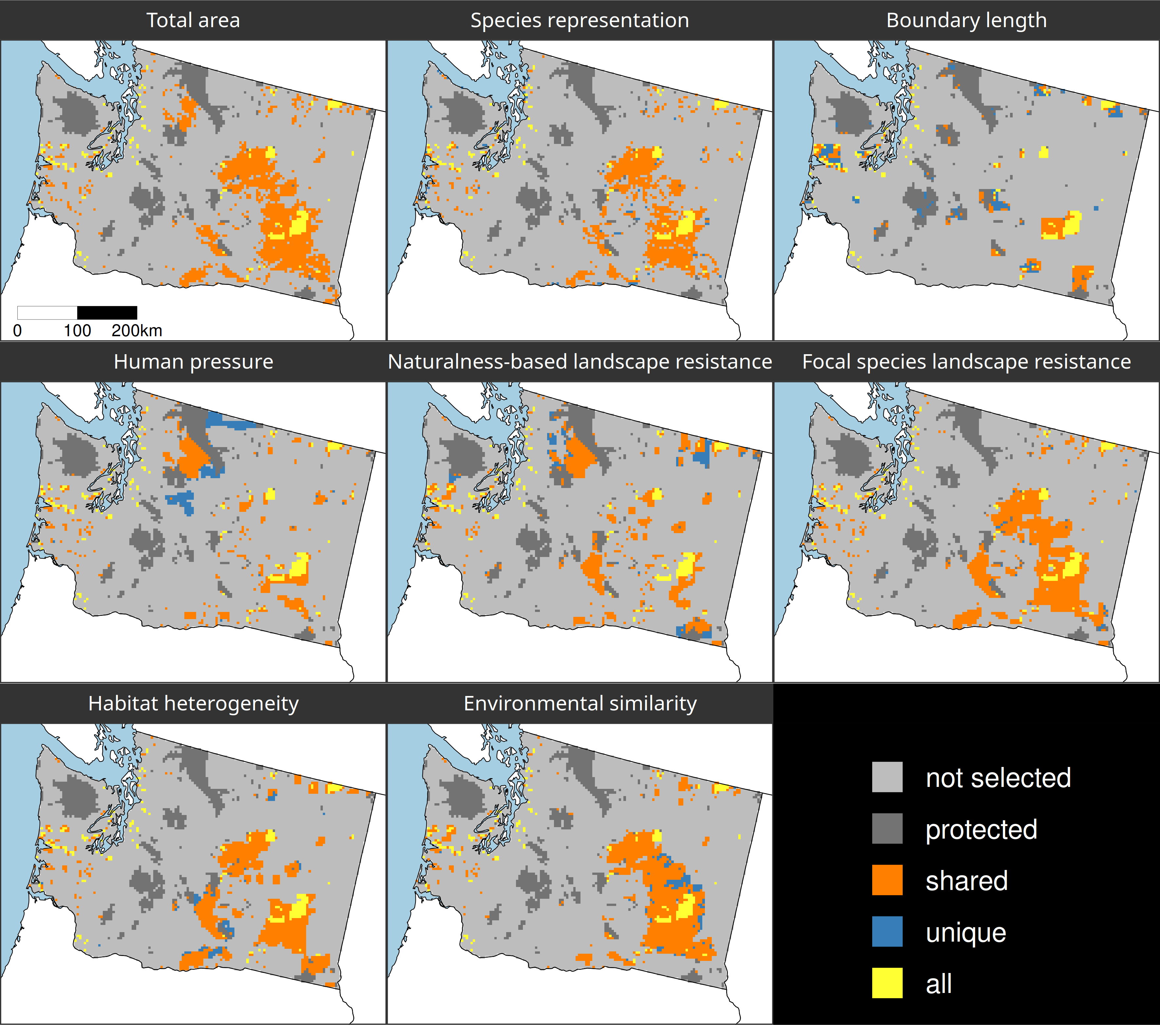
Different connectivity approaches produce different prioritizations
Different connectivity approaches can yield similar prioritizations
Hanson et al. 2022 J. Appl. Ecol

Slide 54
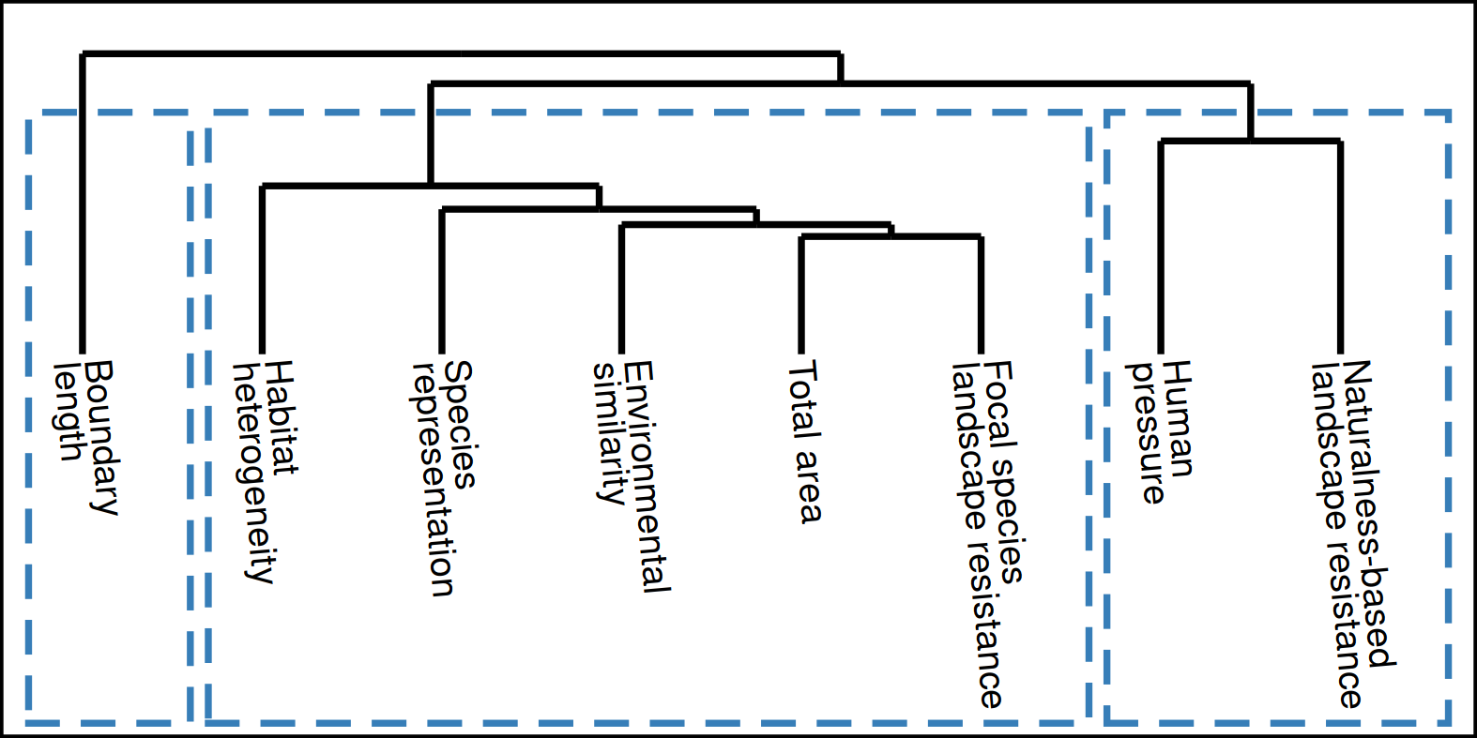
How do the prioritizations compare?
Approach
Habitat-based
Spatial
clustering
Resistance-based
Hanson et al. 2022 J. Appl. Ecol

Slide 55
Make better conservation decisions by using…
1. Better algorithms
2. Cost-effective data
3. Reliable surrogates

Slide 56




jeffrey.hanson@uqconnect.edu.au
github.com/jeffreyhanson
jeffrey-hanson.com

Slide 57
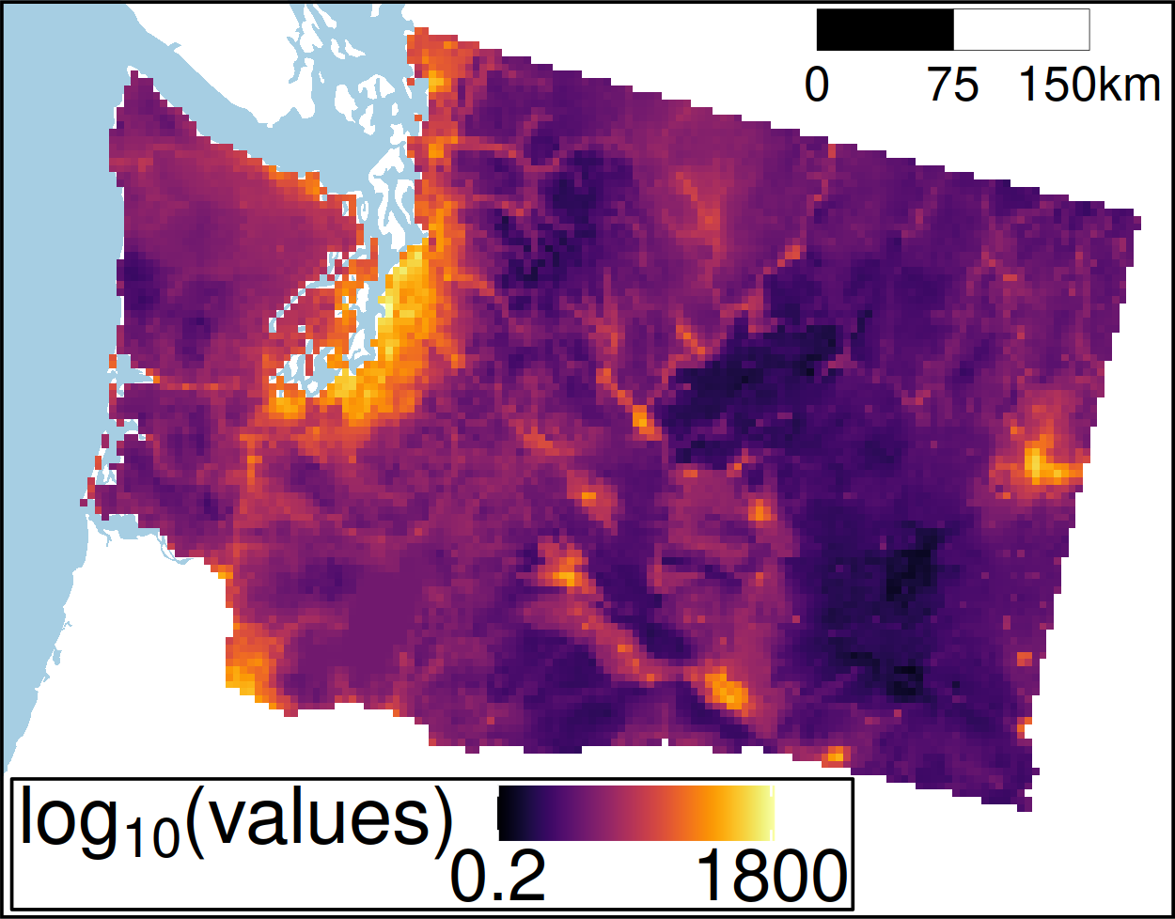

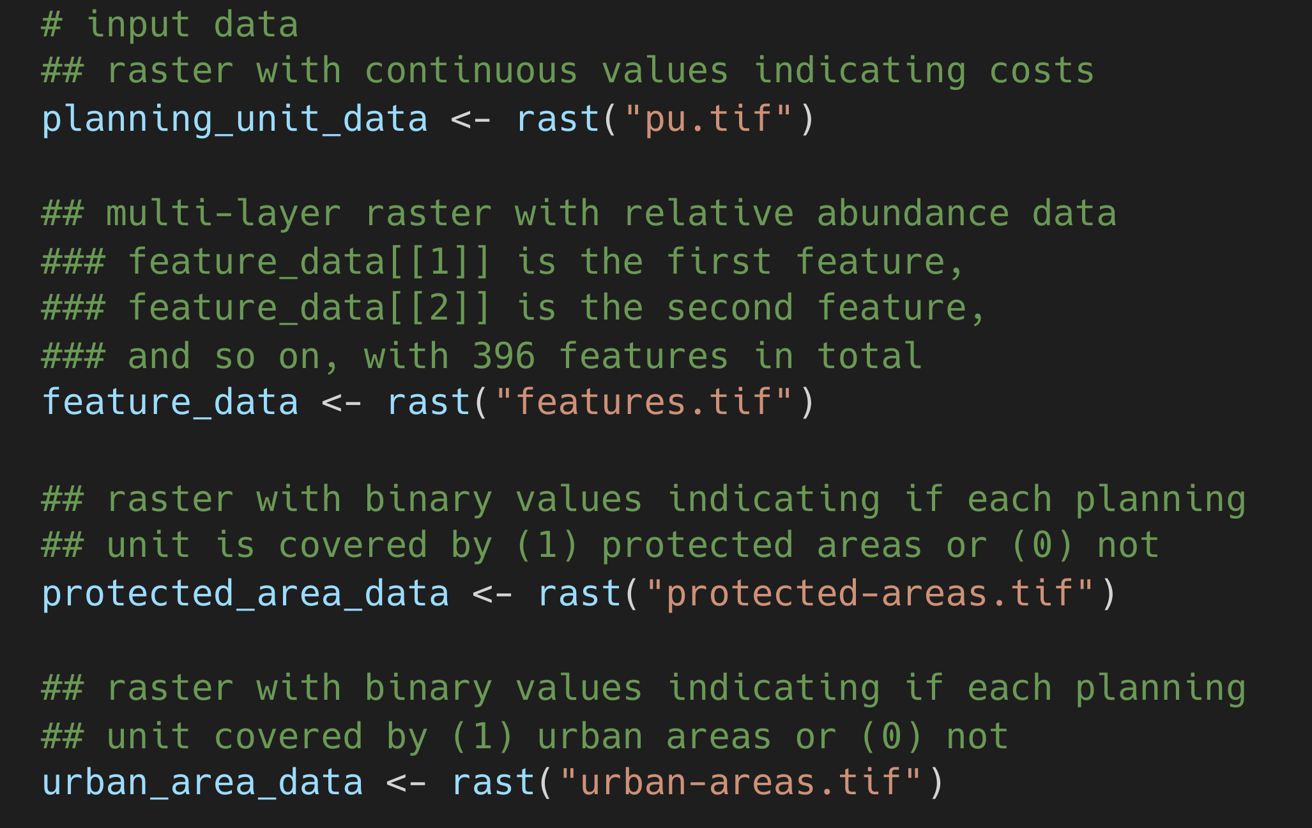
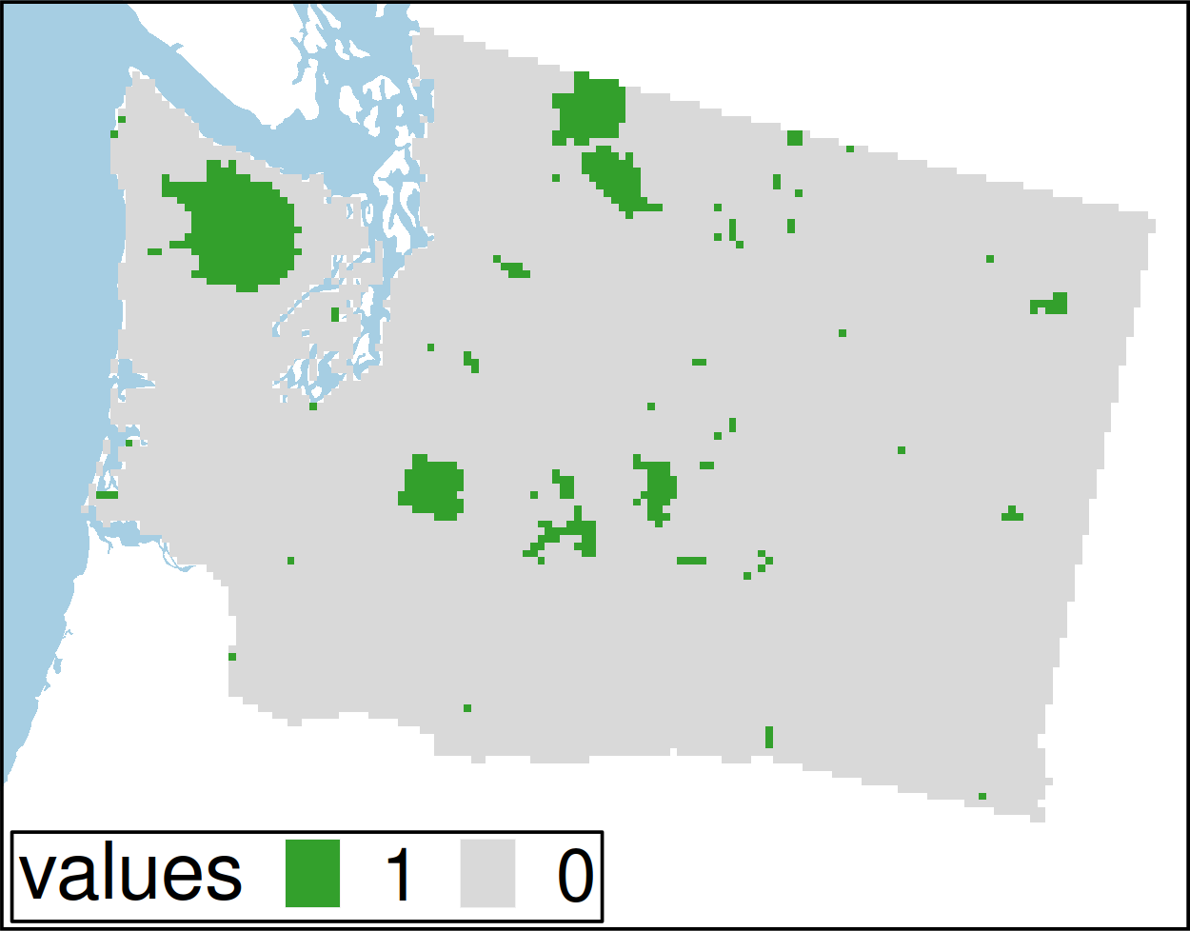
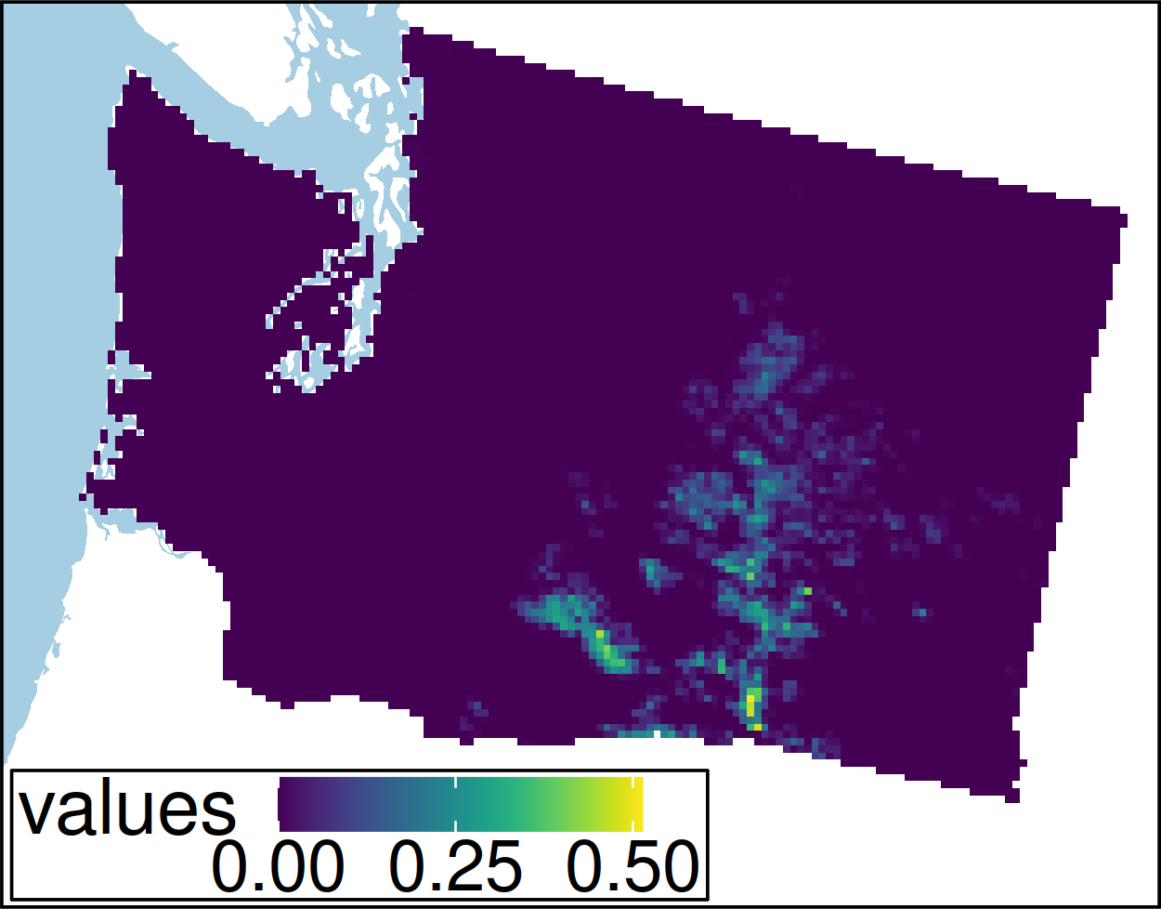
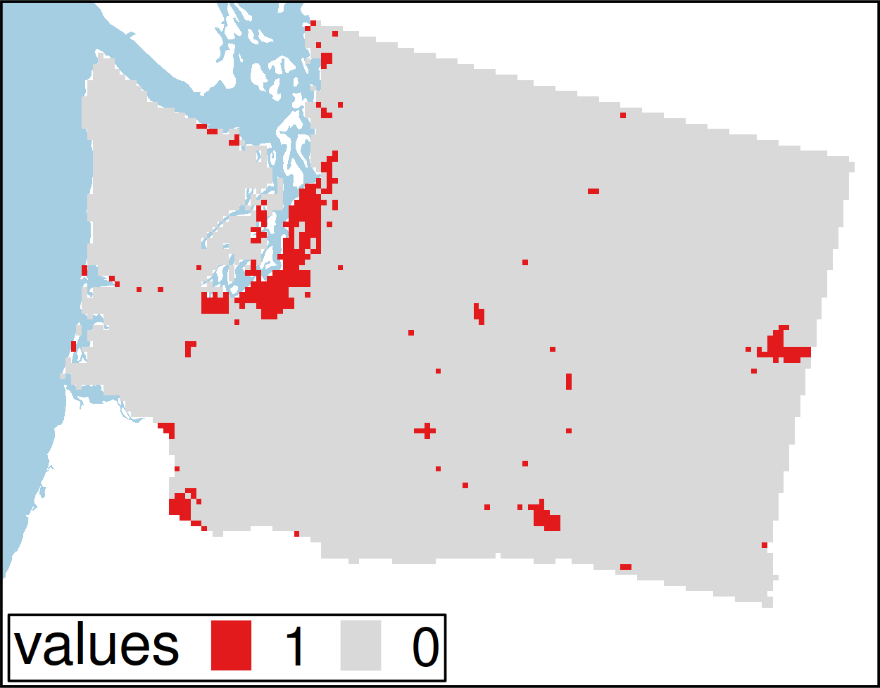
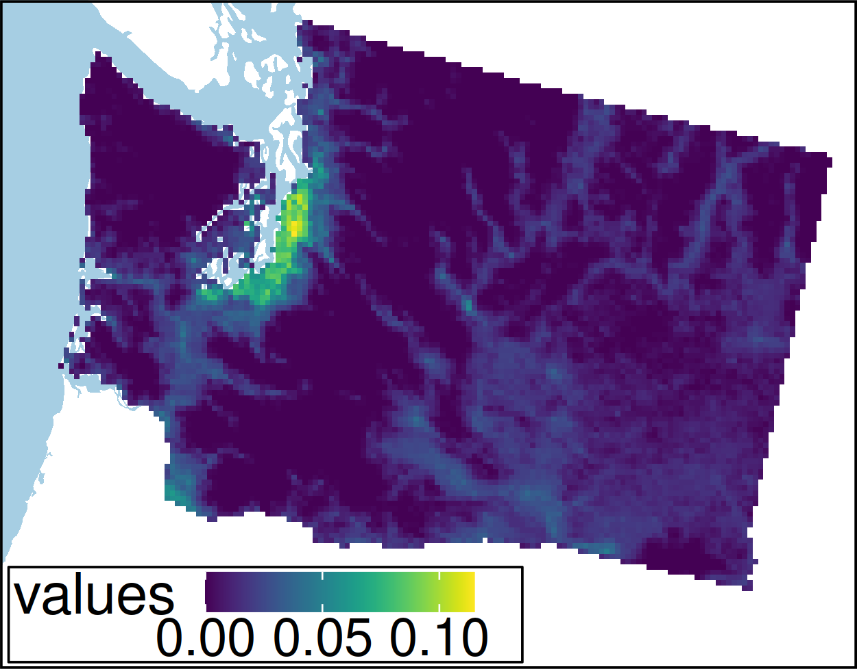
Worked example
Hanson et al. under review

Slide 58
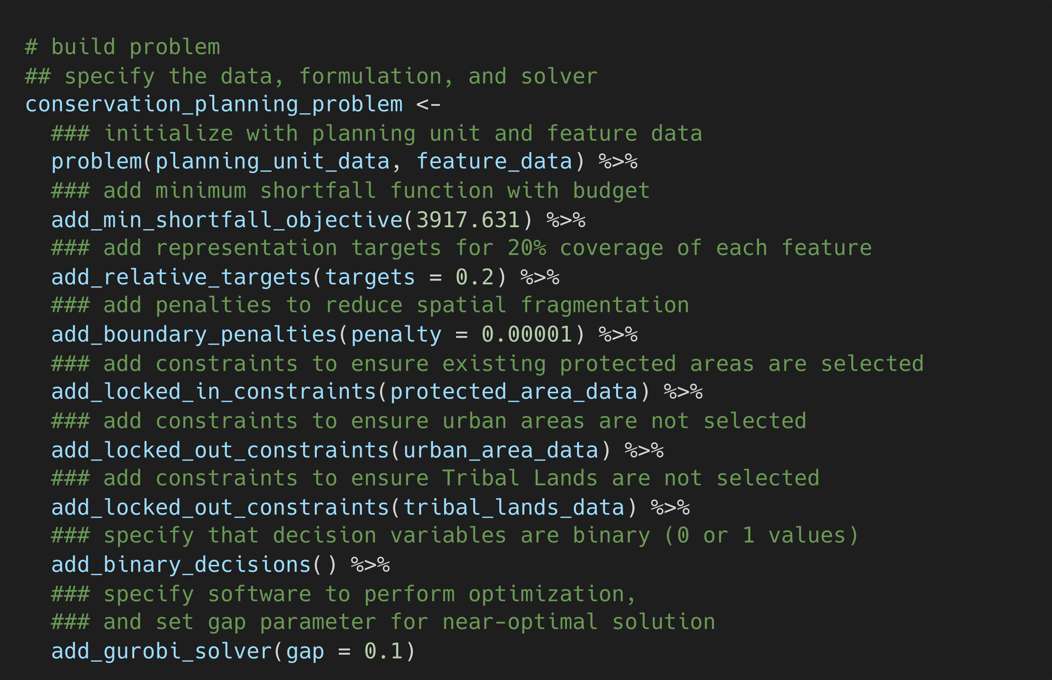
Hanson et al. under review

Slide 59
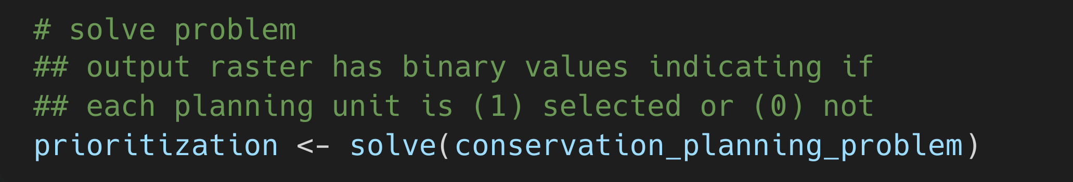
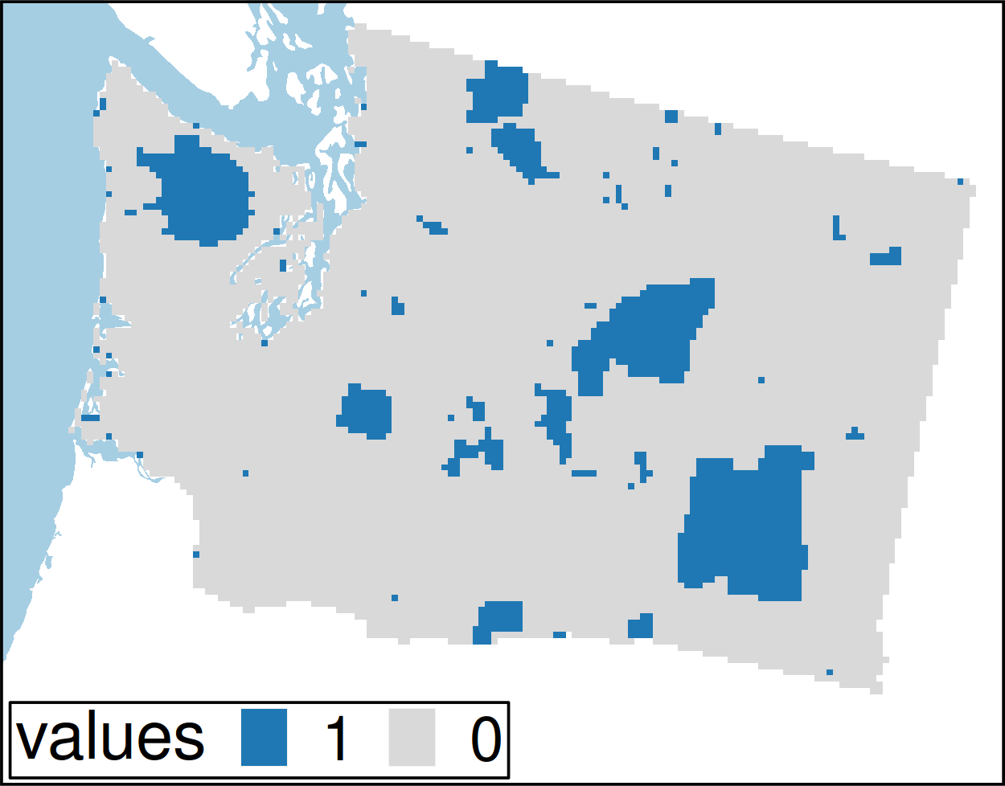
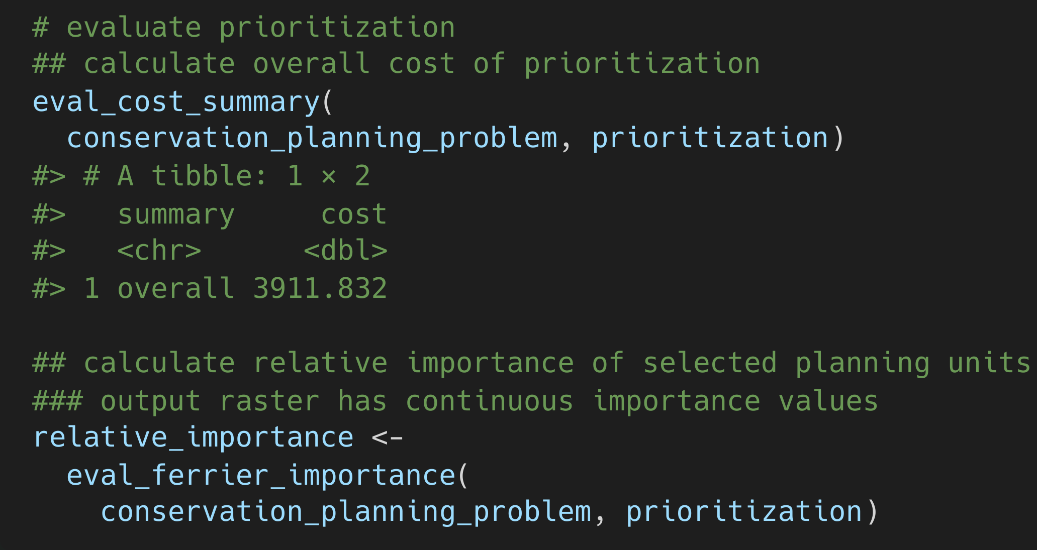
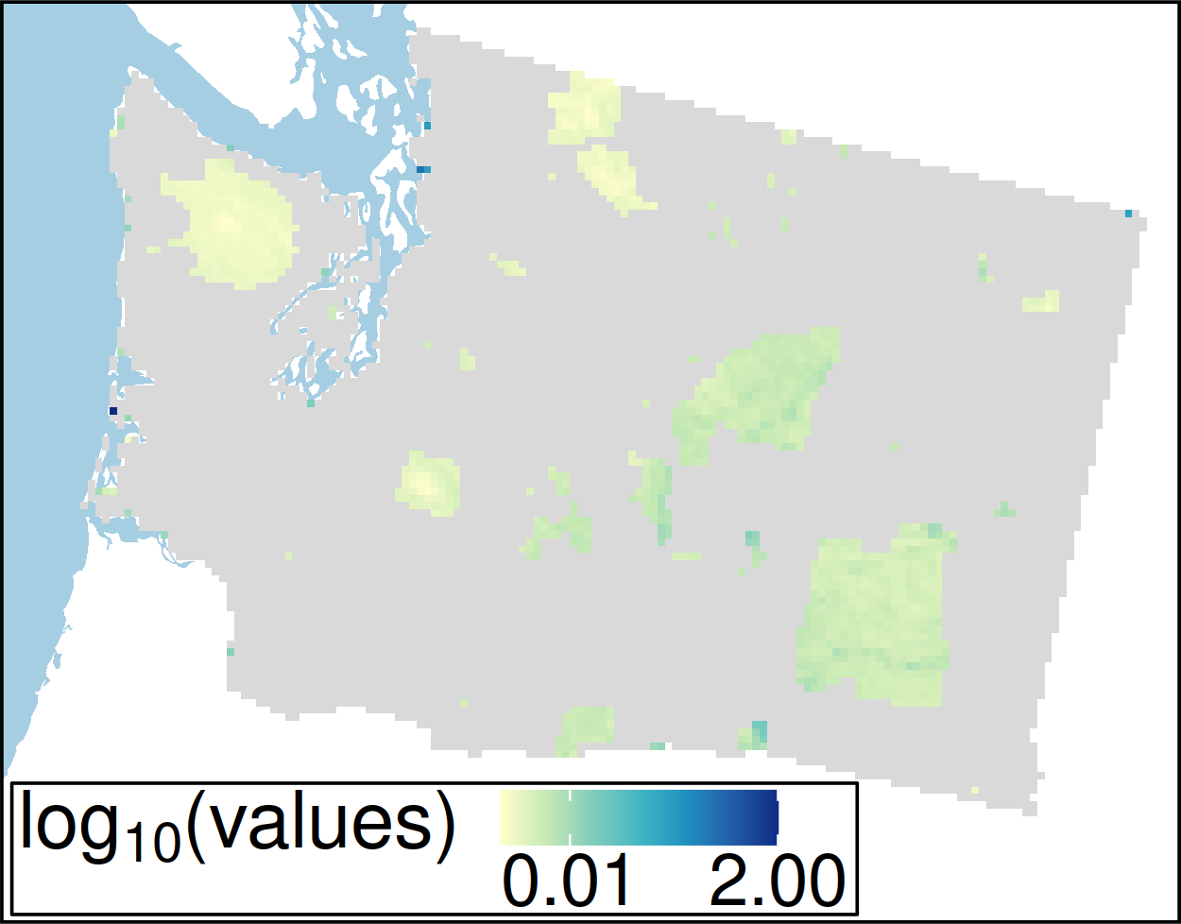
Hanson et al. under review

